Slide 1


Ryders Green
WOW Assembly

Slide 2

1H
Mike

Slide 3

1G
Mehek

Slide 4
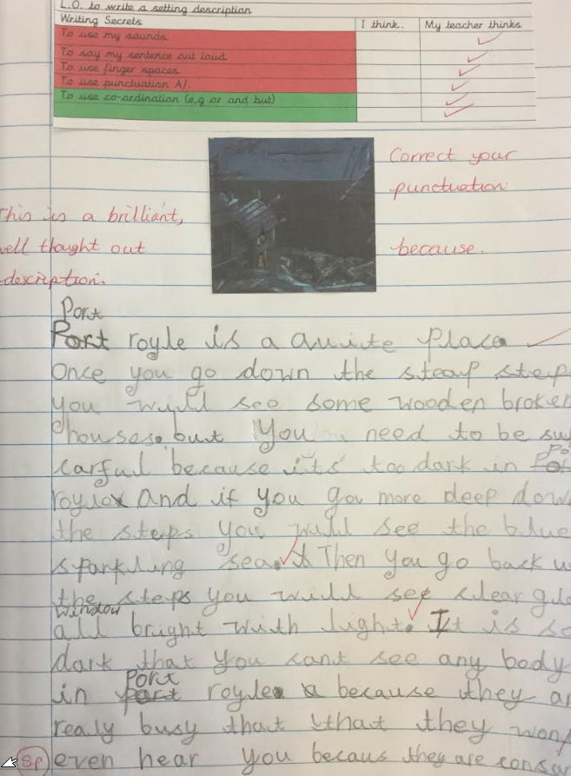
2K
Afsa

Slide 5
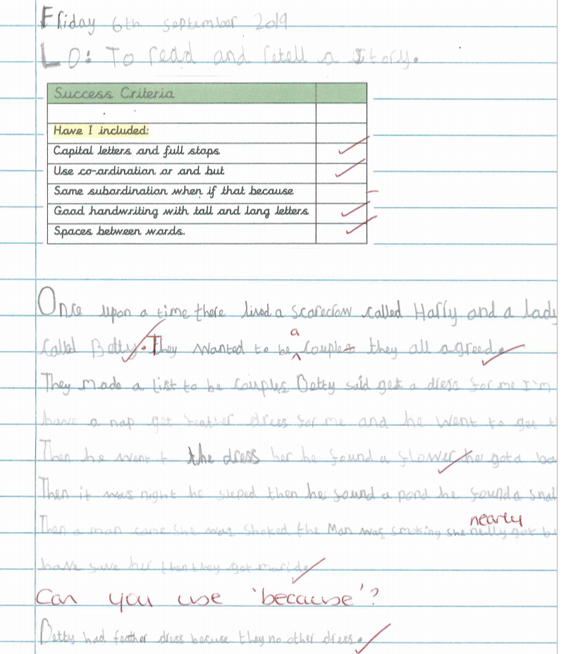
2E
Aliyah

Slide 6
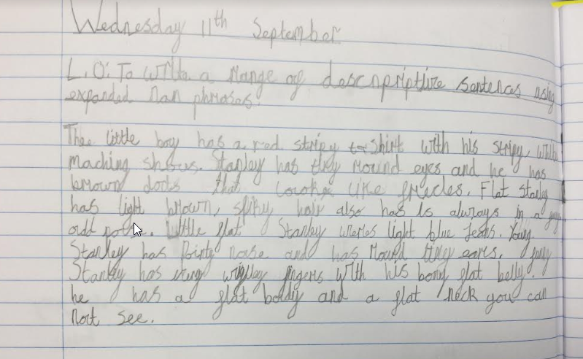

3H
Yusrah

Slide 7
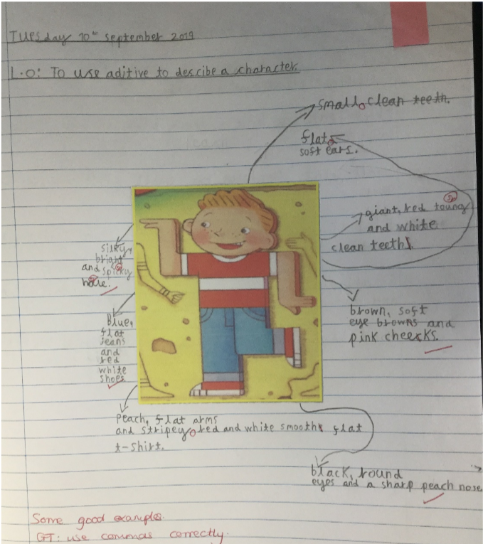
3F
Atreyu

Slide 8
4T
Lee

Slide 9

4R
Filip

Slide 10
5BK
Abdul

Slide 11
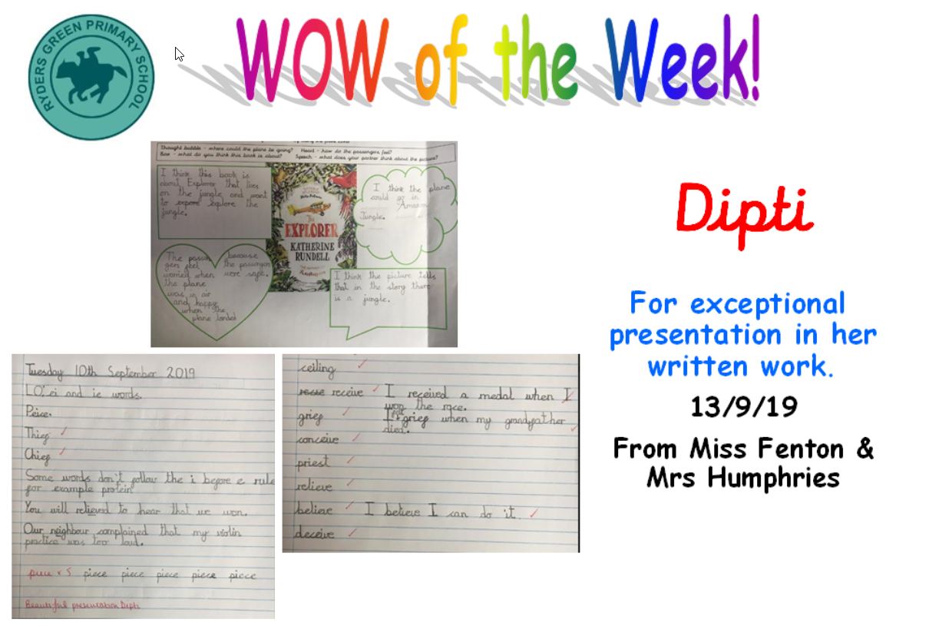
5F
Dipti

Slide 12
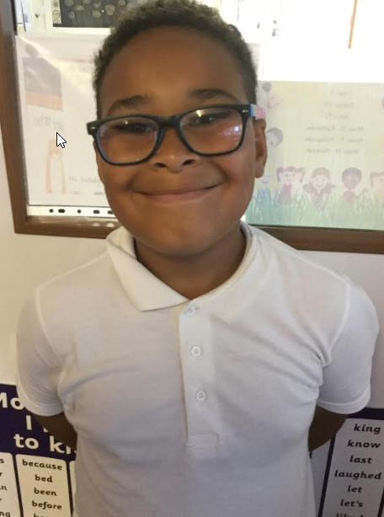
5R
Reece

Slide 13
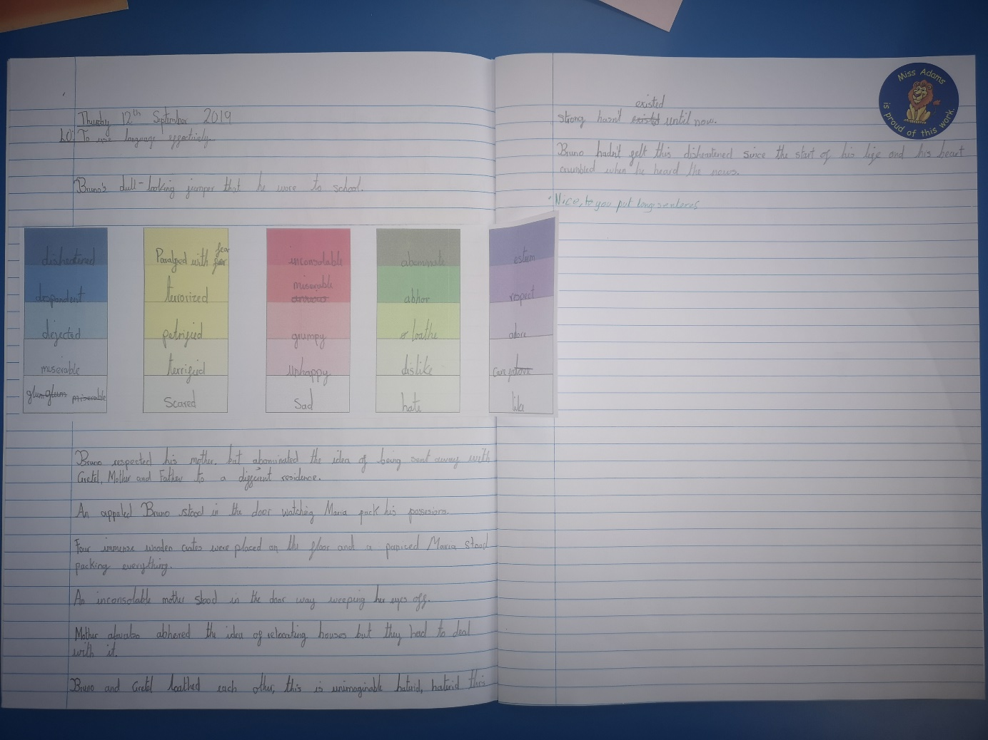
6RSA
Gabriela

Slide 14
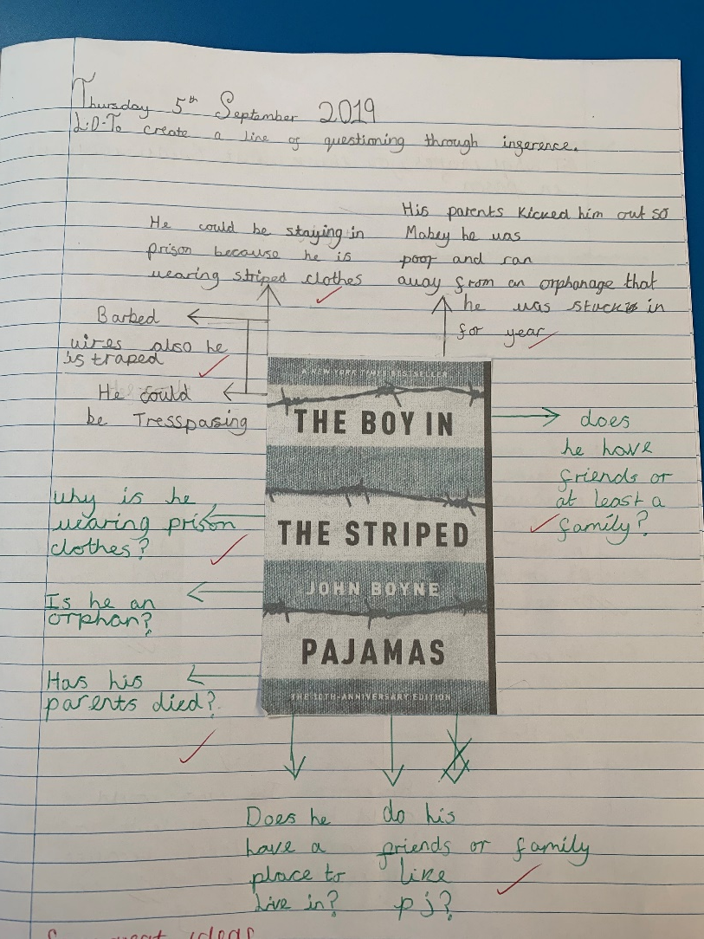

6RLA
Veronica

