Slide 1
Ryders Green
WOW Assembly

Slide 2
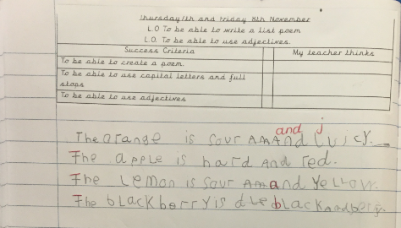
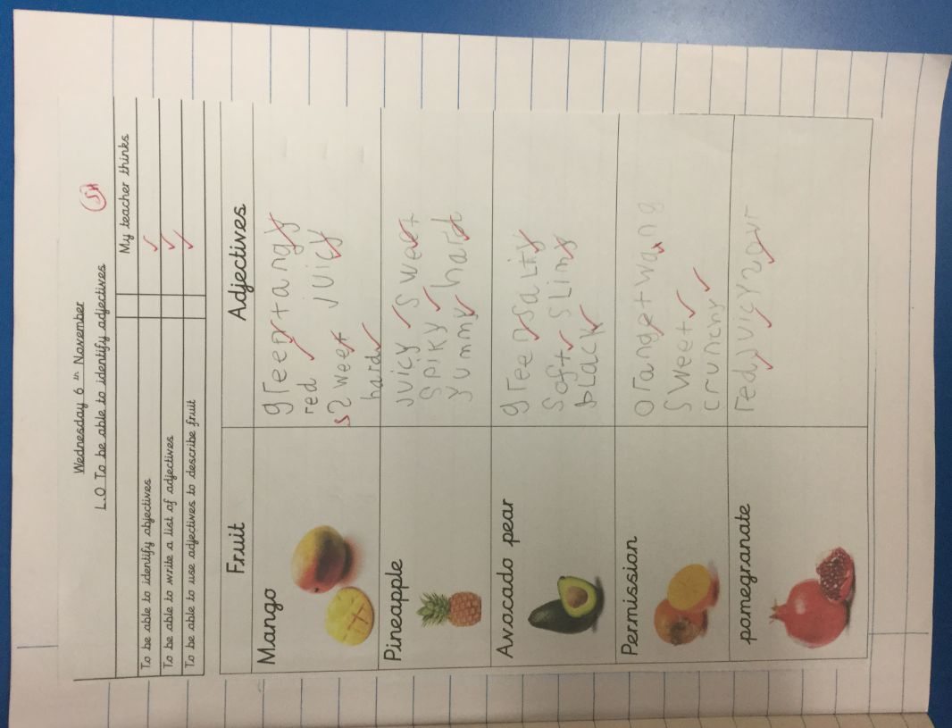
1H

Slide 3
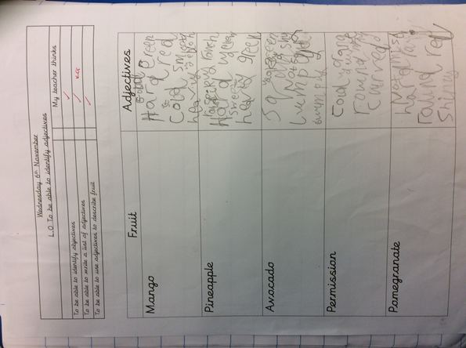
1G
WOW of the Week!
This certificate is awarded to
Ishaan
For outstanding use of phonics in his writing.
From Miss Graham , Miss Robinson and Miss Corbett
8.11.19

Slide 4
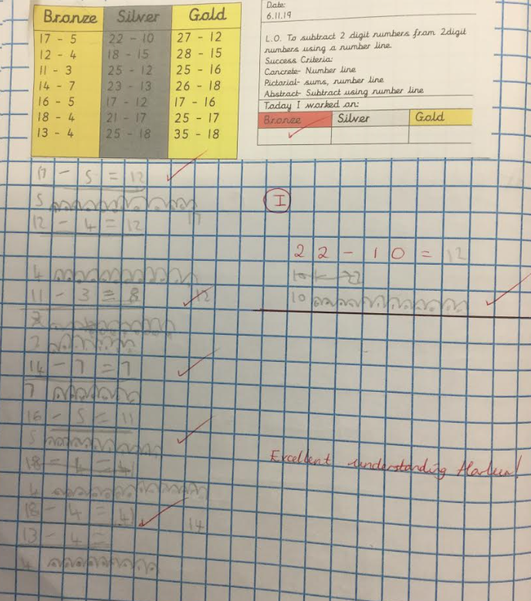
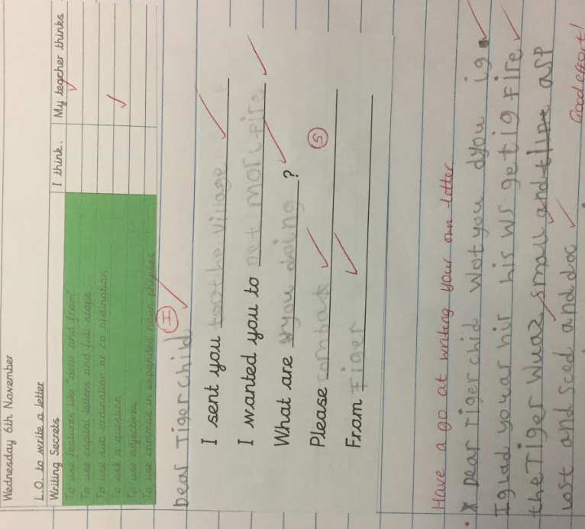
Harleen -2K

Slide 5
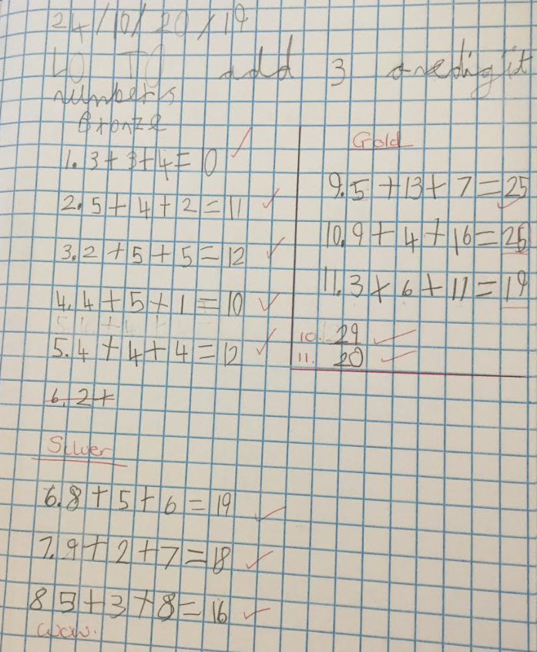
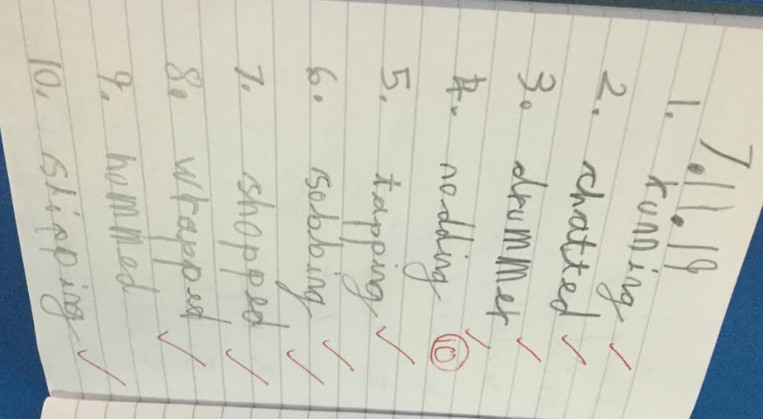
Nelli -2E

Slide 6
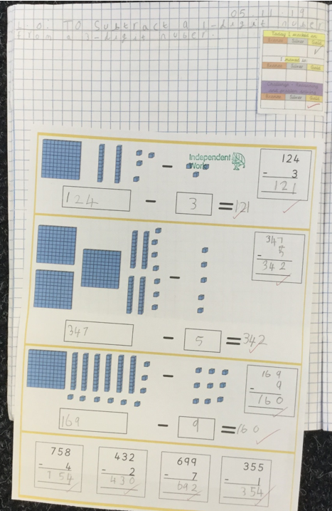
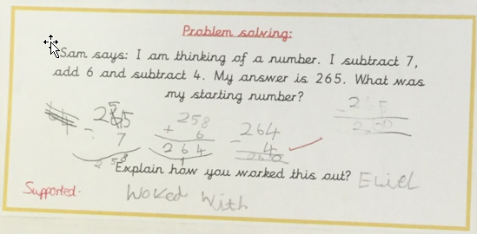
Laciemai 3F

Slide 7
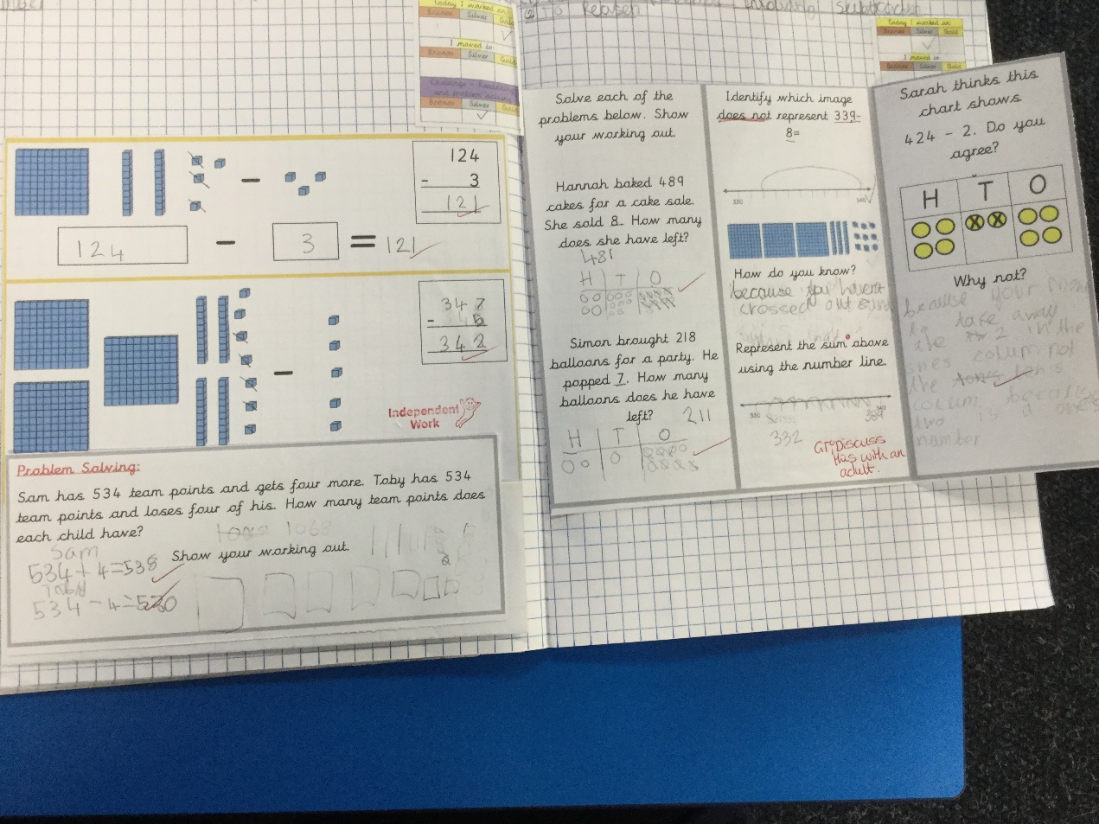
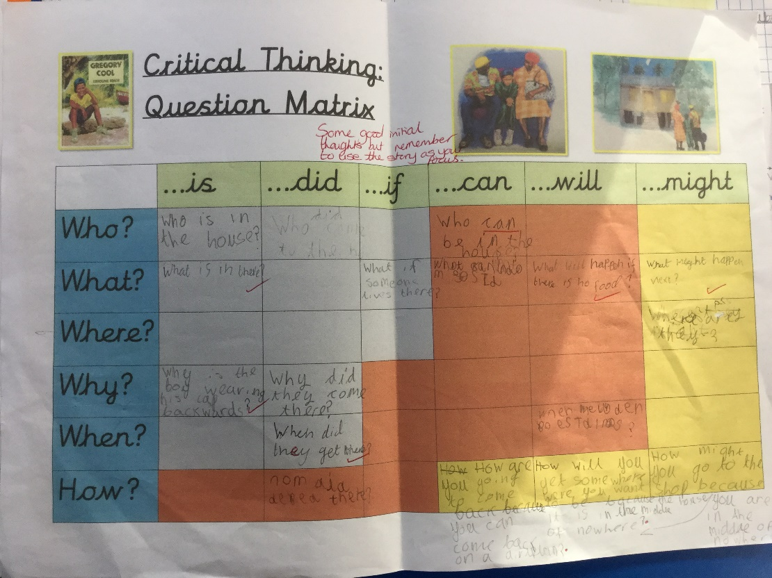
Ava -3H

Slide 8
4T

Slide 9
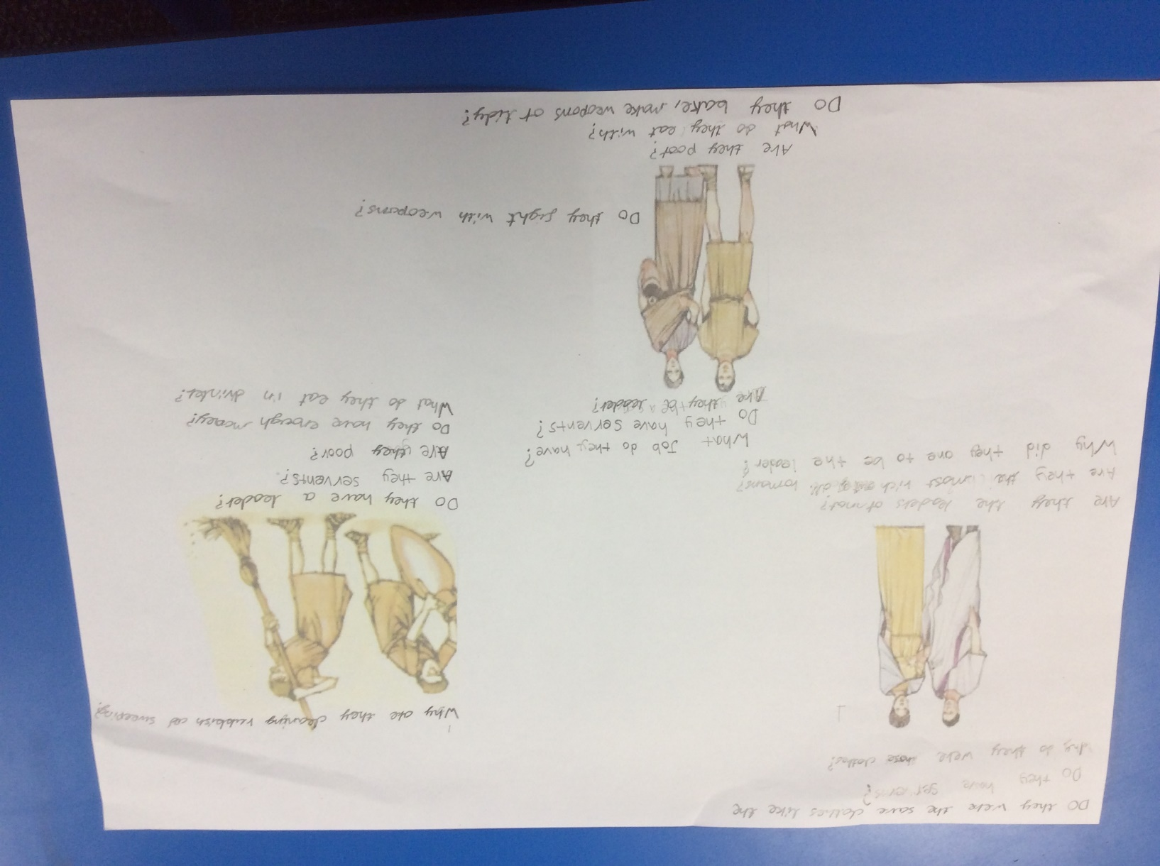
Faye & Omar - 4R
Working together to generate questions for different members of Roman families.

Slide 10
-5R

Slide 11
5F

Slide 12
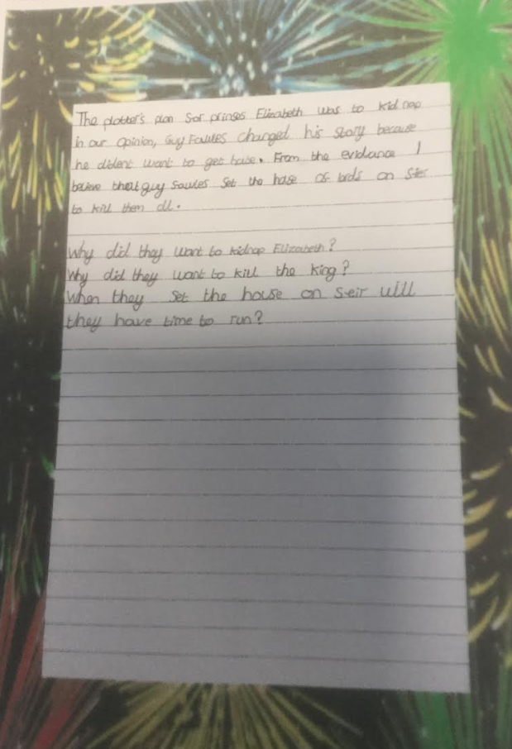
Laura -5BK

Slide 13
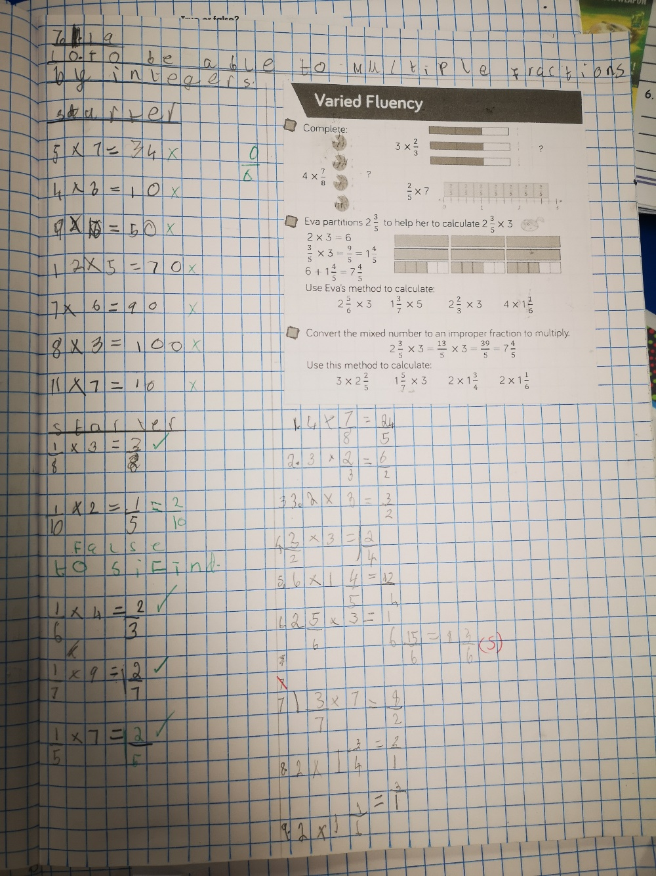
Caitlin-6RSA

Slide 14
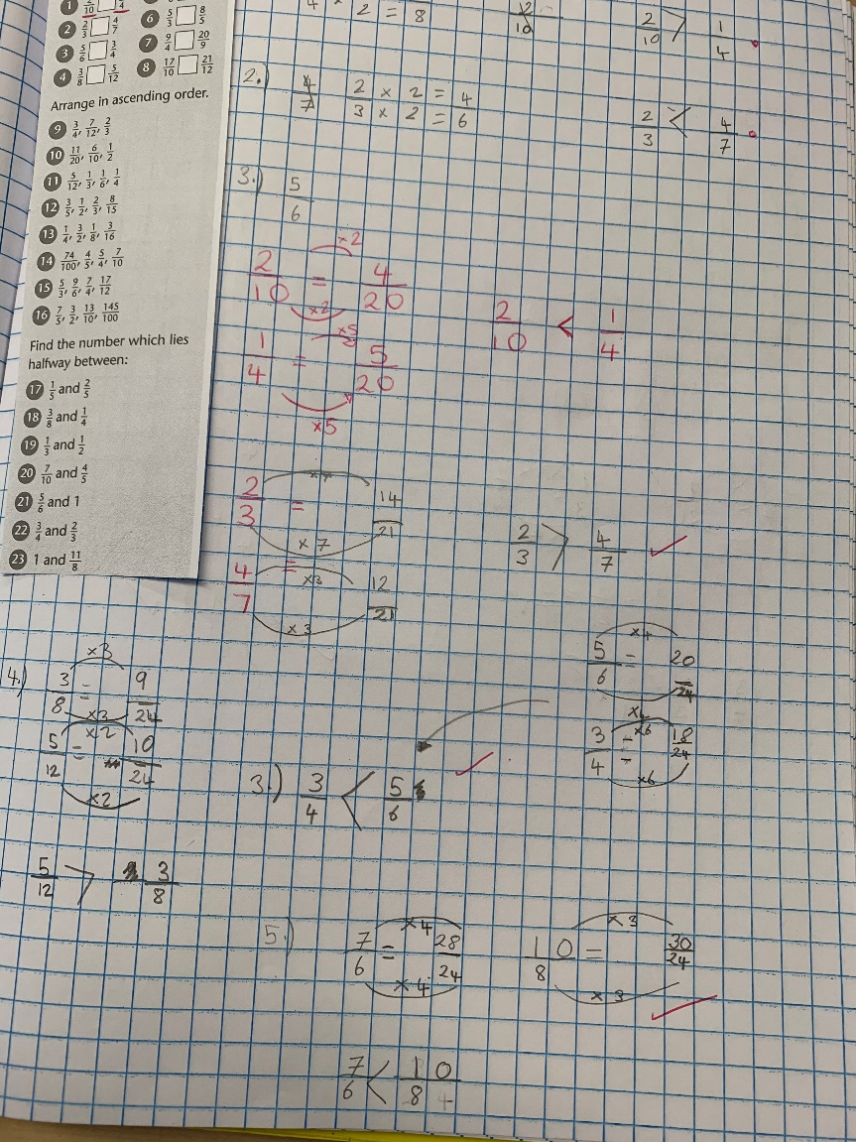
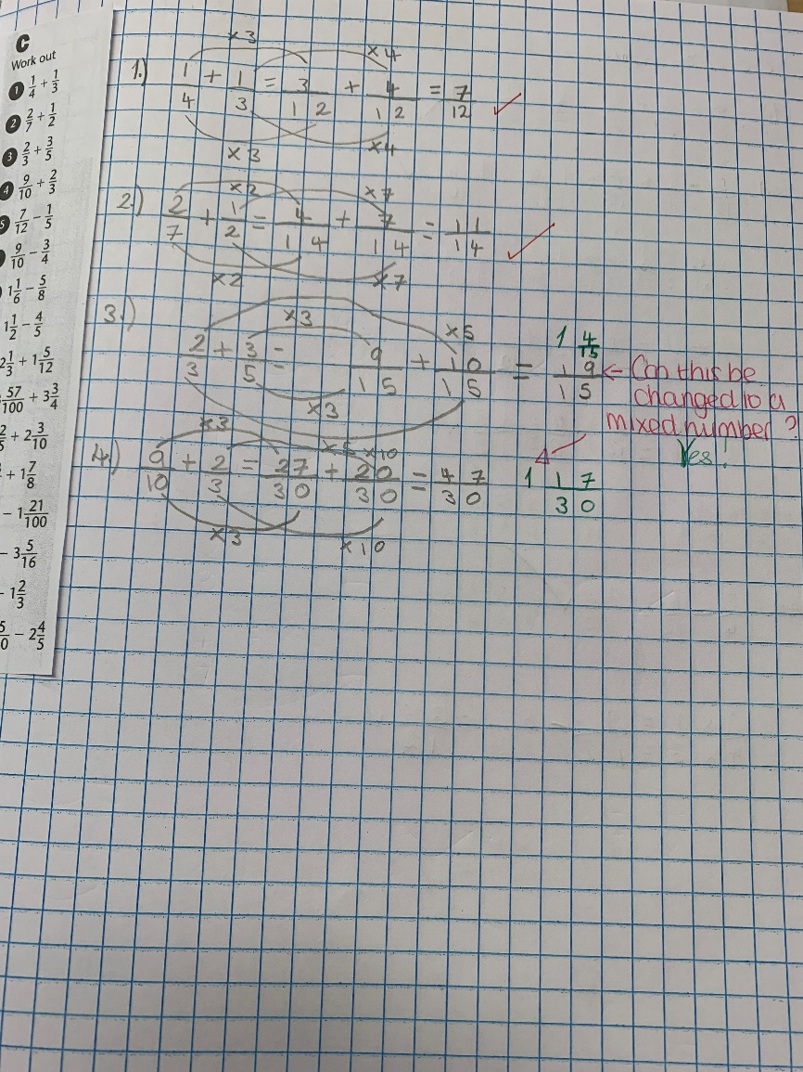
Karina-6RLA

Slide 15
Thank you to all parents and carers for your continued support

