Slide 1
Art Attack: Listen to a piece of classical music: how does it make you feel? Does it tell a story? What colours are the sounds? Create a piece of art- draw, paint, collage…maybe even make it ‘digital’! | Raise Your Voice: Sing some of your favourite songs to entertain your neighbours from your window or garden: maybe you can get others to join in from their homes! | Visit the West End! From home of course. Explore examples of Musical Theatre. Get inspired to turn your favourite book or story into a musical. | From the Year….: Find and listen to a song from the year that you were born. Do the same for your parents and grandparents years of birth- how has music changed over time?
On This Day…: Research to find which famous musicians and or composers share your birthday. Find out more about them and listen to their music. | Be the Conductor! Grab a ‘baton’ (use a pencil, chopstick or a wand) and conduct pieces of music in 2, 3, 4 and 5 beat metres. | Clap Your Hands: Learn a new clapping game and teach it to someone else. And then make up your own. | STOMP: Use everyday household items to make music.
Sing Scat: Learn about Louis Armstrong , listen to some of his music and ‘scat’ along. | Hambone: Research what ‘Hambone’ is and then use body percussion to play along with other music or make up music of your own. | God Save the Queen: Learn to sing the national anthem. Listen to other anthems from other countries. | Rap it Up: Learn to rap to the ‘Fresh Prince of Bel Air’ (Your parents will probably join in!)

Slide 2
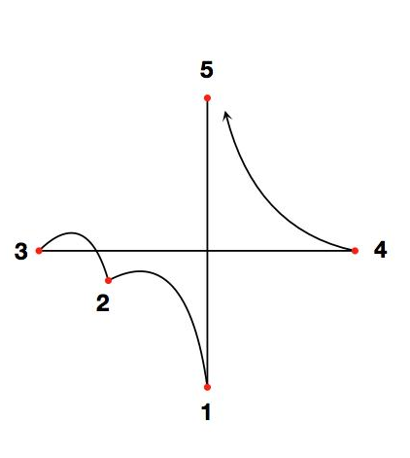
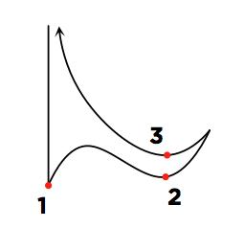
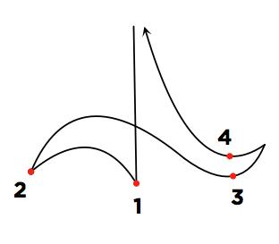
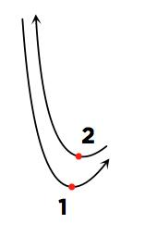
Conducting Masterclass
Watch professional conductor, Marin Alsop give hints and tips on learning how to conduct these different time signatures, or metres (amounts of beats per bar) in her masterclass ‘Beating Time’ for Classic FM.
These diagrams show the patterns for waving the baton for different metres: 2, 3, 4 and 5.

Slide 3

Conductor: grab your ‘baton’ and keep the beat with the BBC Ten Pieces.
Habanera from the opera, ‘Carmen’ by Bizet: 2 beats per bar
Waltz of the Flowers from the ballet, ‘Nutcracker’ by Tchaikovsky: 3 beats per bar
In the Hall of the Mountain King from the play, Peer Gynt, music by Grieg: 4 beats per bar
Mars from ‘The Planets’ by Holst: 5 beats per bar
Listen to a more pieces and try to figure out if there are 2, 3, 4, 5, 6 or even beats per bar!

Slide 4
Musicals from the ‘West End’ (London) and ‘Broadway’ (New York City)
‘Wicked’: an alternative retelling of the story of The Wonderful Wizard of Oz, a book by L. Frank Baum
‘Matilda’: a musical based on the book by Roald Dahl
Lion King: the live stage version of the musical Disney film
Anything Goes: all singing, all dancing musical number in the style of the Broadway musicals of the 1940’s.

Slide 5
Fresh Prince of Bel Air lyrics
Verse 1: Now this is a story all about how
My life got flipped—turned upside down
And I'd like to take a minute, just sit right there,
I'll tell you how I became the prince of a town called Bel-Air.
Verse 4: But wait I hear they're prissy, bourgeois, all that
Is this the type of place that they just send this cool cat?
I don't think so I'll see when I get there
I hope they're prepared for the prince of Bel-Air.
Verse 2: In west Philadelphia born and raised
On the playground was where I spent most of my days
Chillin' out maxin' relaxin' all cool and
Shooting some b-ball outside of the school
When a couple of guys who were up to no good
Started making trouble in my neighbourhood
I got in one little fight and my mom got scared She said,
"You're movin' with your auntie and uncle in Bel-Air."
Verse 3 I begged and pleaded with her day after day
But she packed my suitcase and sent me on my way
She gave me a kiss and then she gave me my ticket.
I put my Walkman on and said, "I might as well kick it."
First class, yo, this is bad
Drinking orange juice out of a champagne glass.
Is this what the people of Bel-Air living like?
Hmm, this might be alright
Verse 5: Well, the plane landed and when I came out
There was a dude who looked like a cop standing there with my name out
I ain't trying to get arrested yet I just got here
I sprang with the quickness like lightning, disappeared
Verse 6: I whistled for a cab and when it came near
The license plate said "Fresh" and it had dice in the mirror
If anything I could say that this cab was rare But I thought, "Nah, forget it." – "Yo, home to Bel-Air.“
Verse 7: I pulled up to the house about seven or eight
And I yelled to the cabbie, "Yo home smell ya later.“
I looked at my kingdom I was finally there
To sit on my throne as the Prince of Bel-Air.

Slide 6

‘God Save the Queen’ Lyrics for verse 1
God save our gracious Queen, Long live our noble Queen, God save the Queen; Send her victorious, Happy and glorious, Long to reign over us, God save the Queen.

