Slide 1
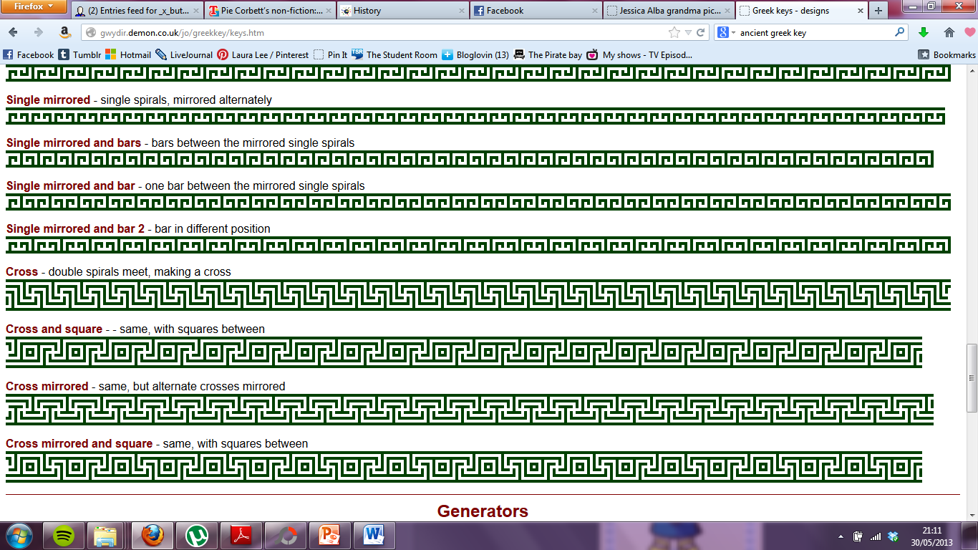

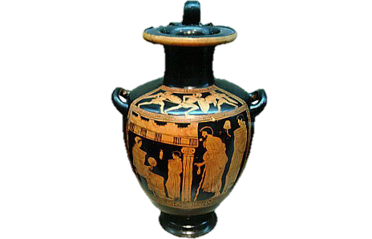
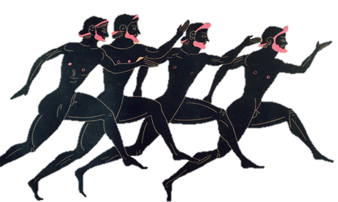
Ancient Greek Pottery

Slide 2


Skill:
To understand what the Ancient Greeks used their different vases for.
To create our own vase design in the style of the Ancient Greeks.

Slide 3
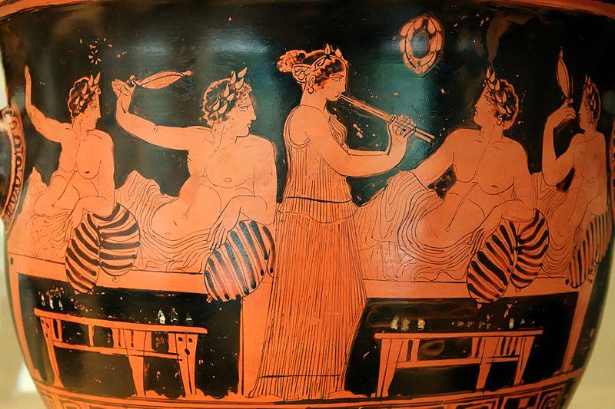
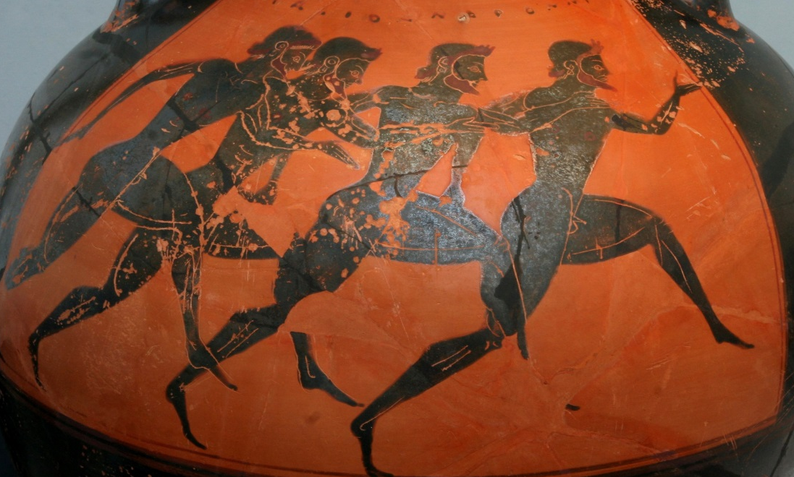
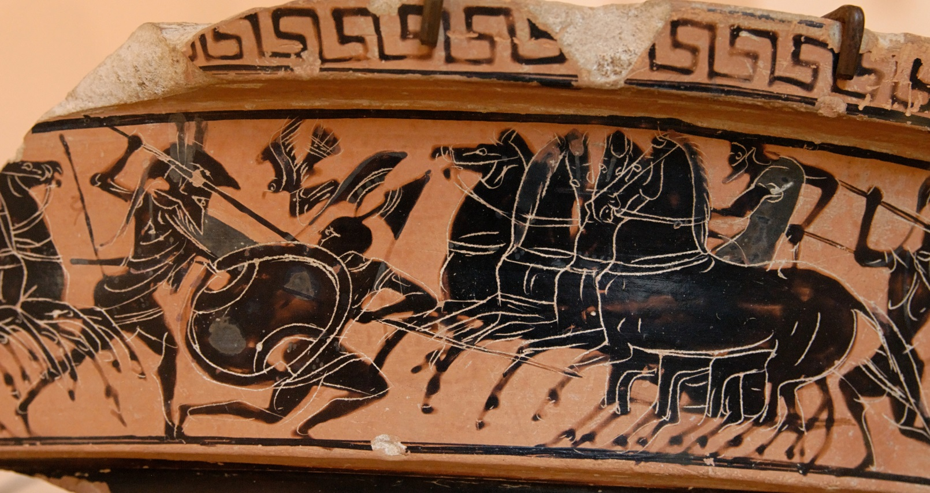

Slide 4
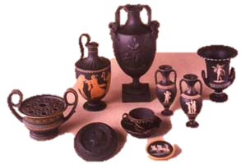
Pots were used for lots of different things.
There were different shapes for different functions.

Slide 5
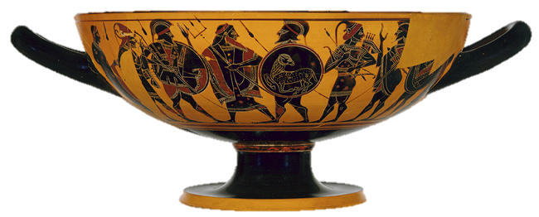
Only men were allowed to make pots in Ancient Greece, although women were allowed to decorate them.

Slide 6
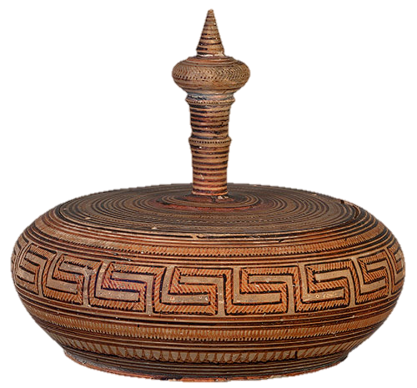
The first pottery was decorated with lots of geometric patterns.

Slide 7
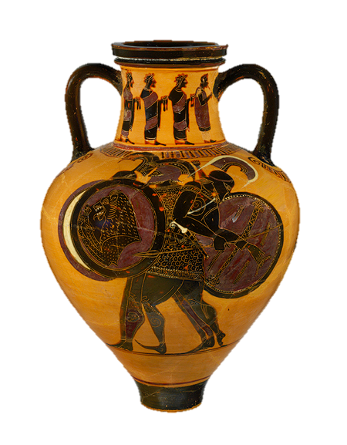
Then came black figure pottery.
The design was made using slip that turned black when fired in the kiln.
White or purple detail was added afterwards.

Slide 8
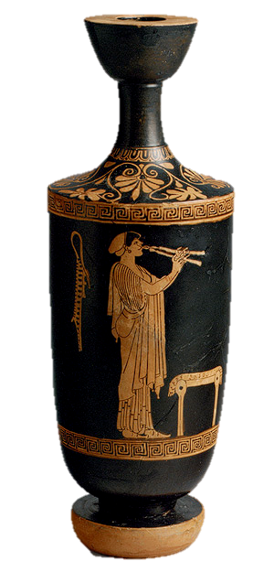
The red figure technique was invented around 530bc.
This time, the rest of the pot was painted with slip rather than the figures and patterns. Detail was added later.

Slide 9
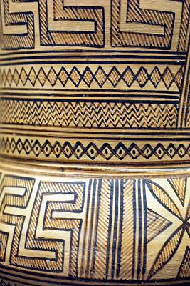
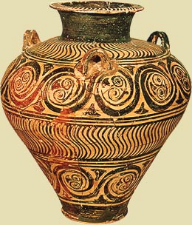
What do you notice about these patterns?

Slide 10
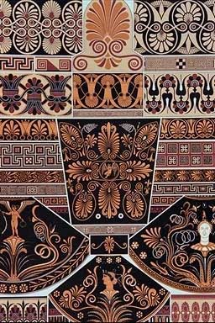
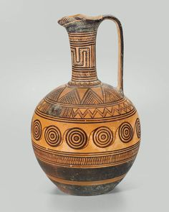

Slide 11
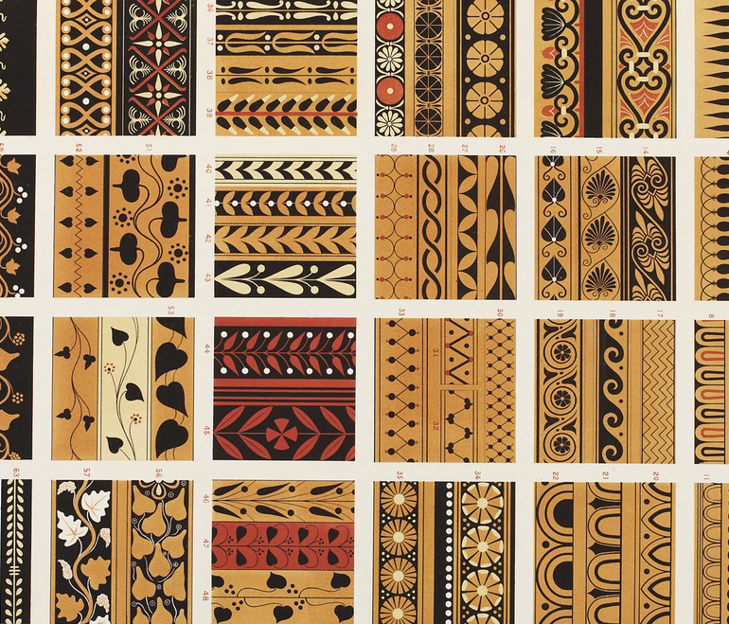

Slide 12
Your Task
Design a vase which uses Ancient Greek styles (geometric styles) and/or shows the Battle of Marathon.
Write about why you have chosen that picture. Draw your vase shape using a template and draw your picture ready for the display.

