Slide 1
BULLYING & CYBERBULLYING
Learning objectives
Learning outcomes
We are learning about the meaning and impact of bullying and cyberbullying, as well as exploring appropriate ways of responding to discriminating, hurtful or intimidating behaviour.
By the end of the lesson you will be able to…
Describe the meaning of bullying and cyberbullying and the impact it can have on an individual
Explore challenging scenarios and their appropriate responses
Explain where to seek support and advice on bullying/cyberbullying.
KEY
VOCABULARY
Social media, discrimination, blackmail, sexting, harassment, race, culture, ethnicity, sex, gender, sexual orientation, prejudice, physical, verbal

Slide 2
BULLYING &
CYBERBULLYING
Your friend posts a comment on social media:
Feeling sad…why won’t people just leave me alone??
What would your first action be after reading this?
What other words would you use to describe your friend’s emotions?
Why do you think your friend has posted this?
How would you support your friend? (Verbal face-to-face contact, online discussion, etc.)
Would you involve other people such as family or friends?
Notes:
Encourage students to reflect silently on the scenario.

Slide 3
BULLYING & CYBERBULLYING
SELF ASSESSMENT
How confident are you about understanding the meaning of bullying and cyberbullying?
How confident are you at describing the impact of bullying and cyberbullying?
How confident are you at knowing how to respond appropriately to bullying and cyberbullying?
How confident are you at knowing where to seek support and advice on bullying and cyberbullying?
0
10
NOT CONFIDENT
EXTREMELY CONFIDENT
Notes:
Students should answer the four baseline questions on a confidence scale: 0 = not confident, 10 = extremely confident.

Slide 4
BULLYING & CYBERBULLYING
TROUBLE ONLINE
What stressful situations occur online?
What causes online arguments?
What are the effects of online arguments?
How can we avoid or get out of conflict online?
ALL
FURTHER CHALLENGE
How does cyberbullying differ from other types of bullying? Why do you think this is?
Why can stopping bullying be so difficult? How is this made even harder when the bullying is online?
Notes:
This can be done on large sheets of paper in pairs/group, or discussed as a group and written individually.
These questions have been differentiated to help facilitate progression through the activity. However, you can choose only the questions that would be appropriate for your students.

Slide 5
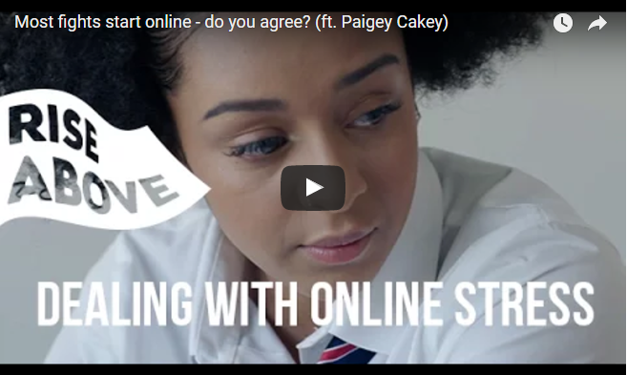
BULLYING & CYBERBULLYING
TROUBLE ONLINE
https://riseabove.org.uk/article/do-most-fights-start-online/
Use a different colour pen to add to your previous answers.
Notes:
Start the video at 2:34 https://riseabove.org.uk/article/do-most-fights-start-online/
Ask students to build on their answers from the previous step, considering similarities and differences and challenging their earlier answers. This can be done in the same pairs/group or discussed as a group and written individually.

Slide 6
BULLYING & CYBERBULLYING
CIRCLES OF SUPPORT
How could each of these groups respond to and support in resolving one of the conflicts below?
Individual
Friends
School
Other e.g. family, police, youth clubs, websites
Malik has just joined the school. He sees his teacher struggling with some books and goes to help him. A group of students see this and mutter ‘freak’ under their breath at him. Every time they see him around school they shove him when they pass him.
Jade overhears her friends talking about a party they are going to at the weekend. She asks them where it is and they change the conversation and pretend to ignore her question. That weekend she sees them posting snapchats from the party saying ‘best friends forever’.
In every English lesson, students get into groups with each other for group-work. Every week, all the other students refuse to work with James, saying that he smells and is dirty. Sometimes they pass him notes with picture of a shower and tell him to ‘have a wash’.
Rhea has been friends with Martha for two years. Rhea checked her phone at break time and saw that Martha has put up a social media status about how she hates hanging out with snitches and has tagged her in it. Later that day she finds that Martha has blocked her on all the social media sites and won’t pick up her calls.
Notes:
Direct students to the Rise Above website for ideas. If devices are not available for students to use, they can discuss in groups using their own knowledge.
Students can create their own diagram or complete in groups. You can direct each pair/group to a scenario or allow students to choose their own.

Slide 7
BULLYING & CYBERBULLYING
CIRCLES OF SUPPORT
ALL
Which actions would be the most supportive and why?
Which circle of support is the most important in your scenario?
FURTHER CHALLENGE
What may be the barriers to accessing these circles of support and how could they be overcome?
Why might some types of bullying be more serious and require more support than others?
Notes:
When students begin to finish their diagrams, have them complete the discussion questions.
You can edit the slide to display the most suitable questions for your class.
These questions have been differentiated to help facilitate progression through the activity. However, you can choose only the questions that would be appropriate for your students.

Slide 8
BULLYING & CYBERBULLYING
PLENARY
School anti-bullying policy
What should be included? Think about everything you discussed.
Don’t forget about cyberbullying!
_________________________________________________________________________
_________________________________________________________________________
_________________________________________________________________________
_________________________________________________________________________
_________________________________________________________________________
Notes:
All students write suggestions on sticky notes or in groups as a list on sheets of paper.
You (or the students themselves) can review the collection of post-its and turn them into a wall display.
Remember to reinforce the message that students must reach out to trusted adults or friends if they are experiencing bullying or suspect that someone they know is being bullied – either in person or online.

Slide 9
BULLYING & CYBERBULLYING
PLENARY
If you, or anyone you know needs support in this area, speak to a trusted adult, a teacher, form tutor or head of year. You can also get support from Childline at: https://www.childline.org.uk/
Notes:
Remember to reinforce the message that students must reach out to trusted adults or friends if they are experiencing bullying or suspect that someone they know is being bullied – either in person or online.
Signpost students to Childline (https://www.childline.org.uk/) and their pastoral system in school, such as their form tutor, head of year or school nurse.

Slide 10
BULLYING & CYBERBULLYING
SELF ASSESSMENT
How confident are you about understanding the meaning of bullying and cyberbullying?
How confident are you at describing the impact of bullying and cyberbullying?
How confident are you at knowing how to respond appropriately to bullying and cyberbullying?
How confident are you at knowing where to seek support and advice on bullying and cyberbullying?
0
10
NOT CONFIDENT
EXTREMELY CONFIDENT
Notes:
Ask students to think back to the confidence line that they shared at the start of the session and consider the same questions.

