Slide 1
Monday 1st June 2020
L.O. To count in multiples of ten.

Slide 2
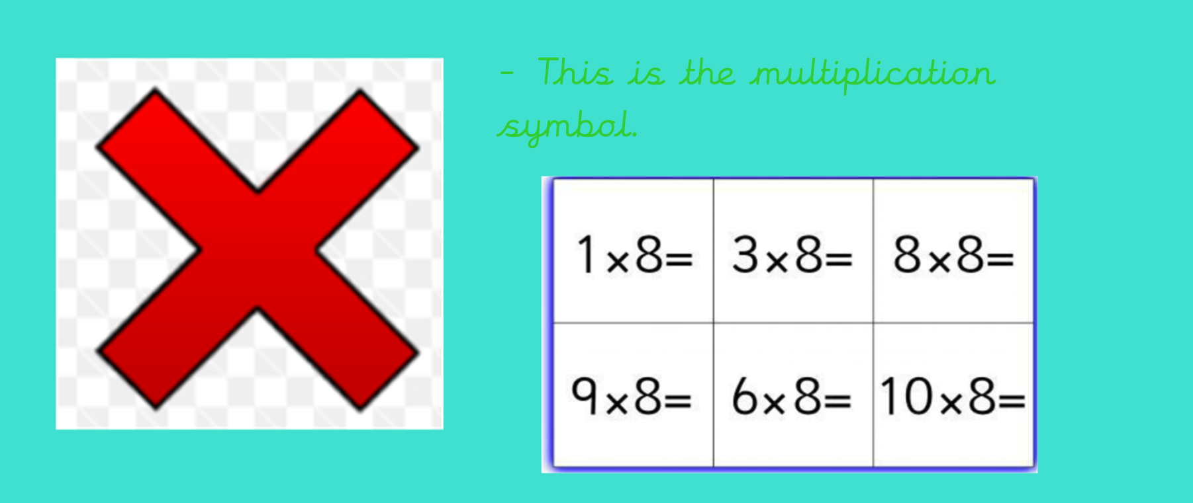

Slide 3
Discuss: What pattern do you notice about the numbers in the ten times tables?
We should learn to count in tens because it is a lot faster to count the total of larger numbers and it is quicker than counting in 1's.

Slide 4
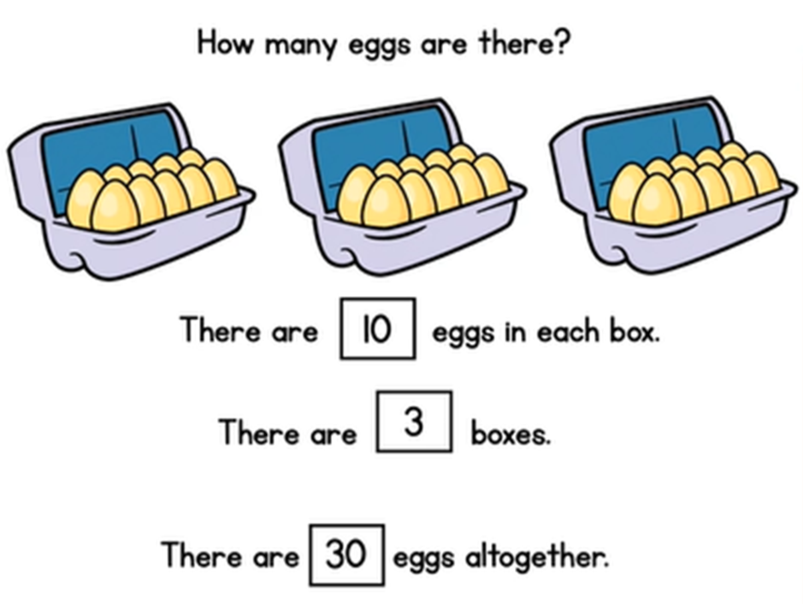
Can you write the multiplication number sentence for this equation.

Slide 5
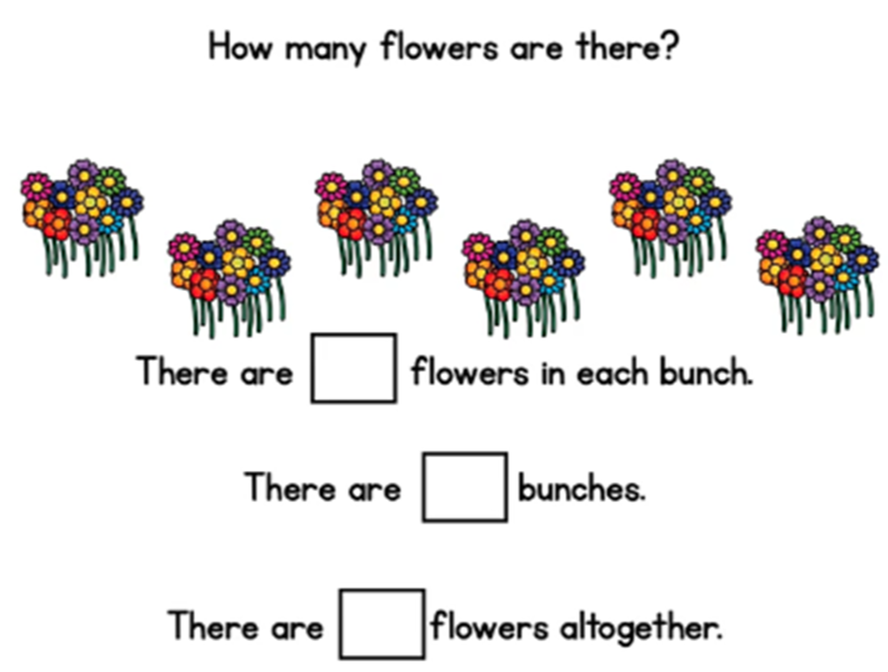
Complete the equation above.

Slide 6
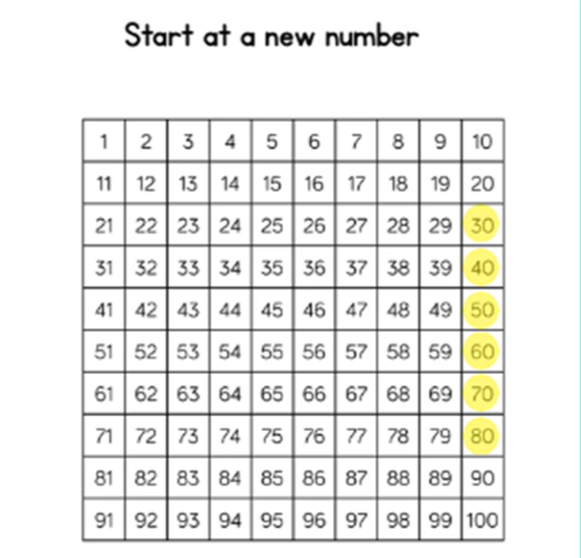
We don't always start at 10 and count on.
Sometimes we have to start at a new number.
For example, if we start at 30 and count to 80.
- Lets try some more:
Start at 60 and count to 90.
Start at 20 and count to 70.

Slide 7
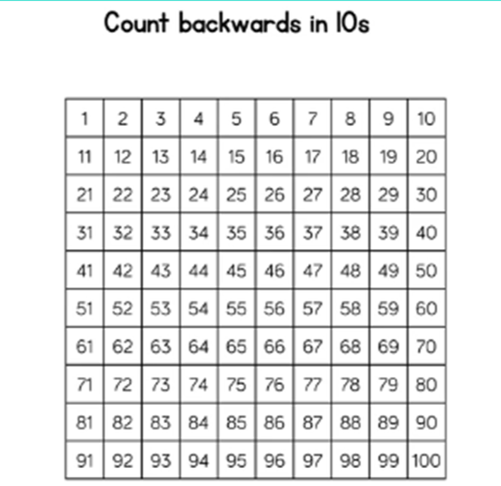
Something else that we should practice is not always counting forwards in 10's but counting backwards too.
- Lets try some more:
Start at 70 and count backwards.
Start at 50 and count backwards.

Slide 8
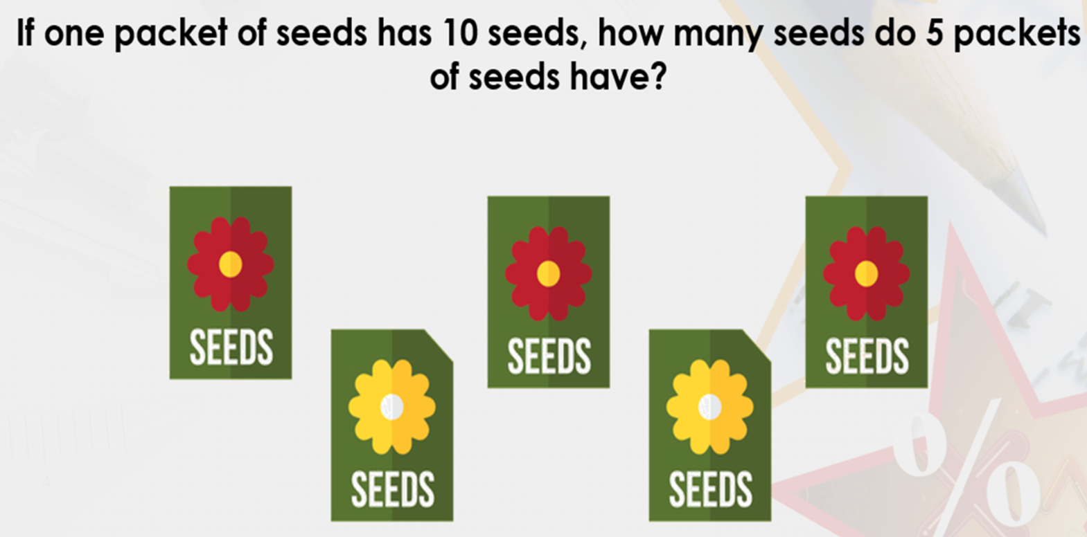

Slide 11
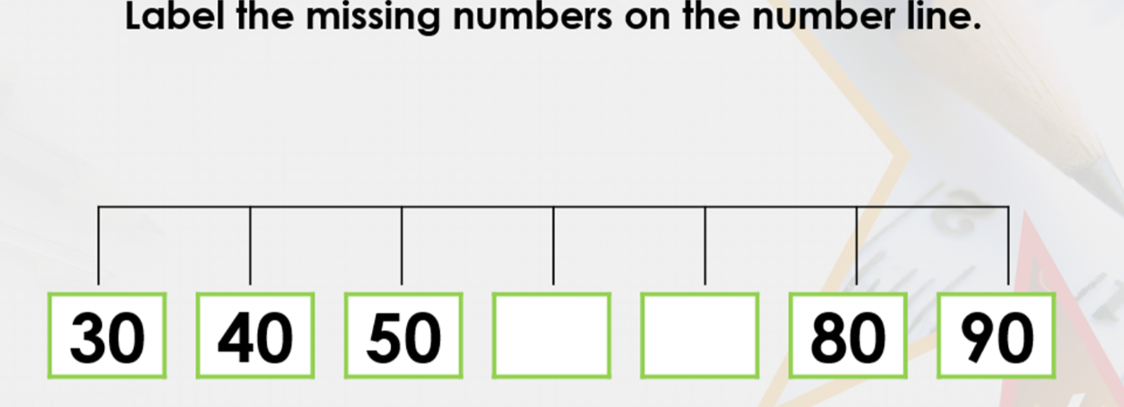

Slide 14
Worksheet for today’s lesson is available in links under ‘Monday’s Worksheet’.

Slide 15
Tuesday 2nd June 2020
L.O. To make equal groups.

Slide 18
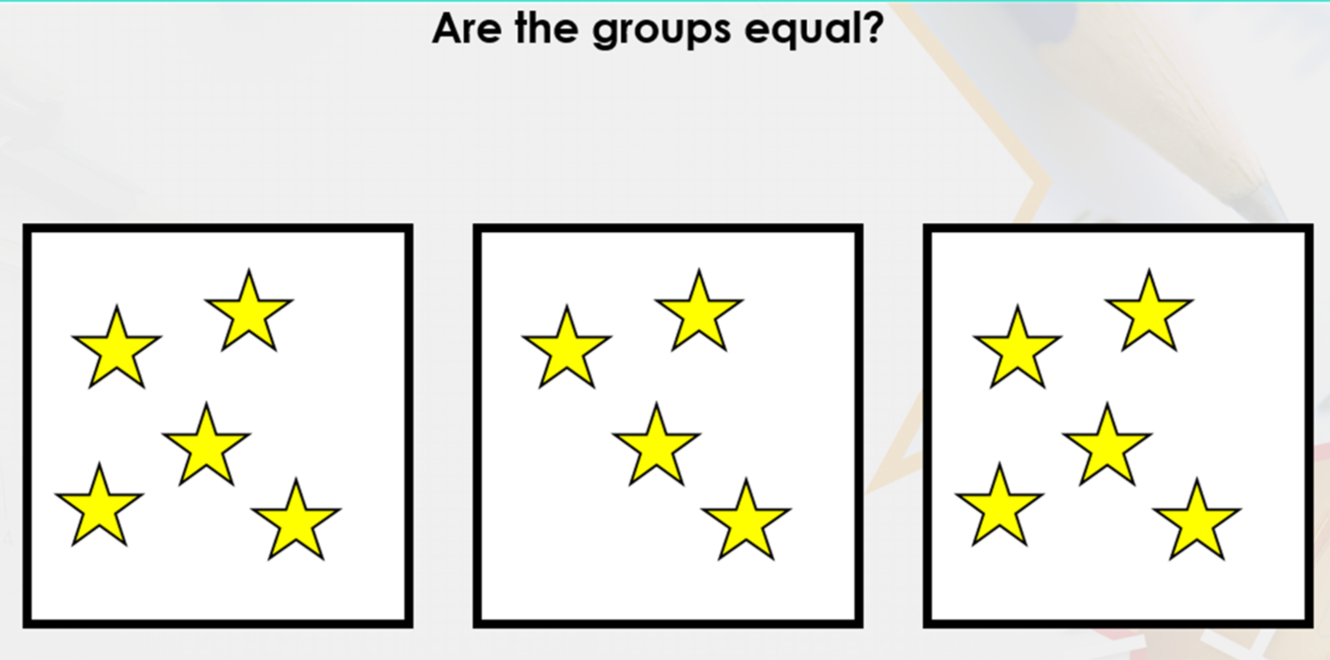

Slide 23
Worksheet for today’s lesson is available in links under ‘Tuesday’s Worksheet’.

Slide 24
Wednesday 3rd June 2020
L.O. To make equal groups.

Slide 25
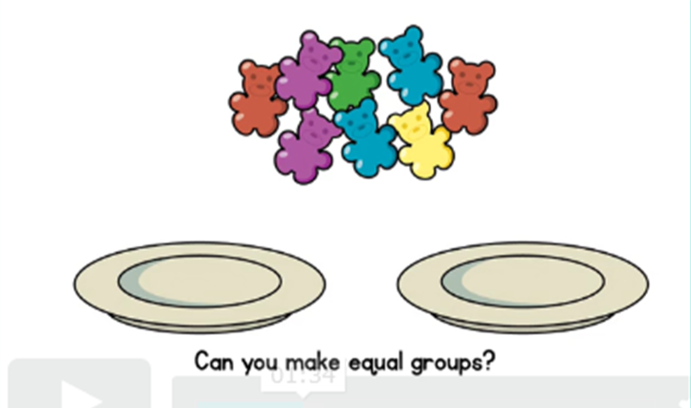
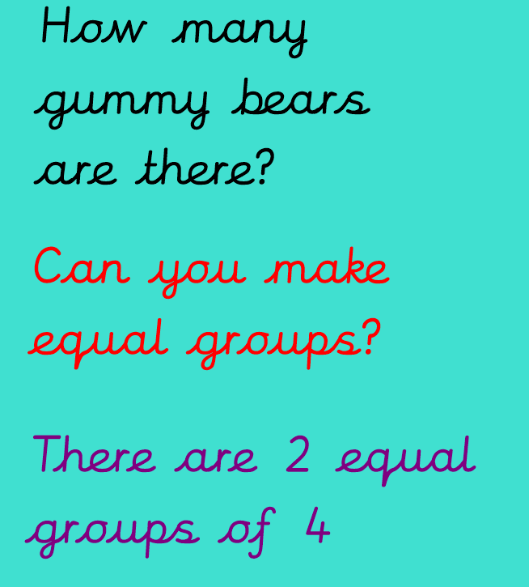

Slide 26
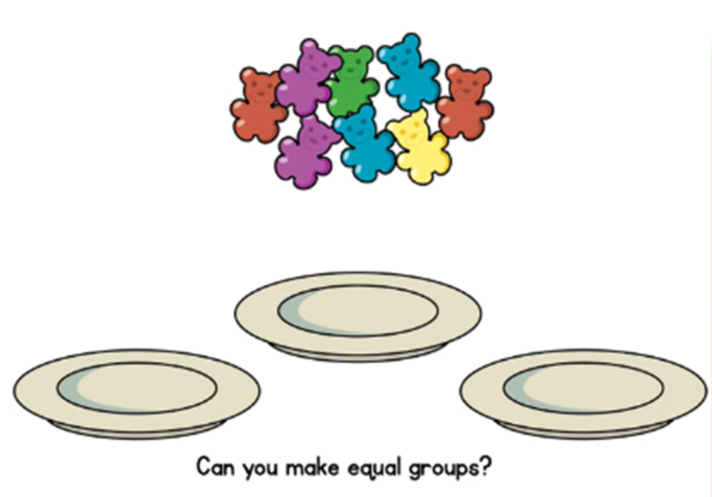
- We still have 8 gummy bears.
- It still wants us to make equal groups.
- This time we have three plates instead of two.
- Can we make equal groups?

Slide 27
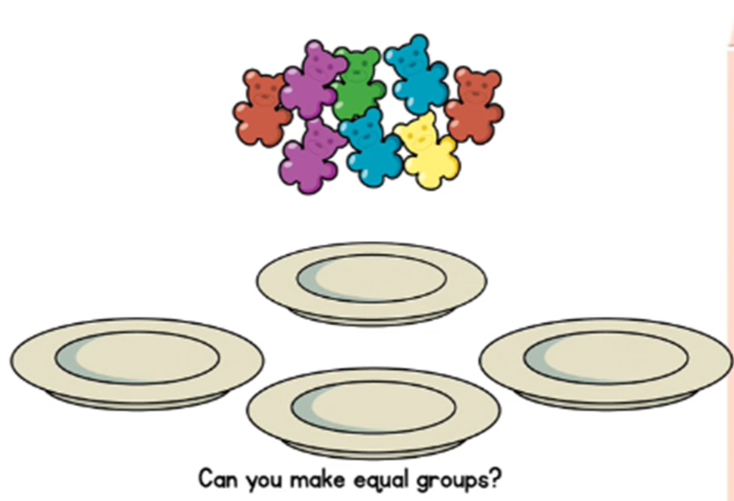
How many equal groups will there be once the gummy bears have been shared out?

Slide 28
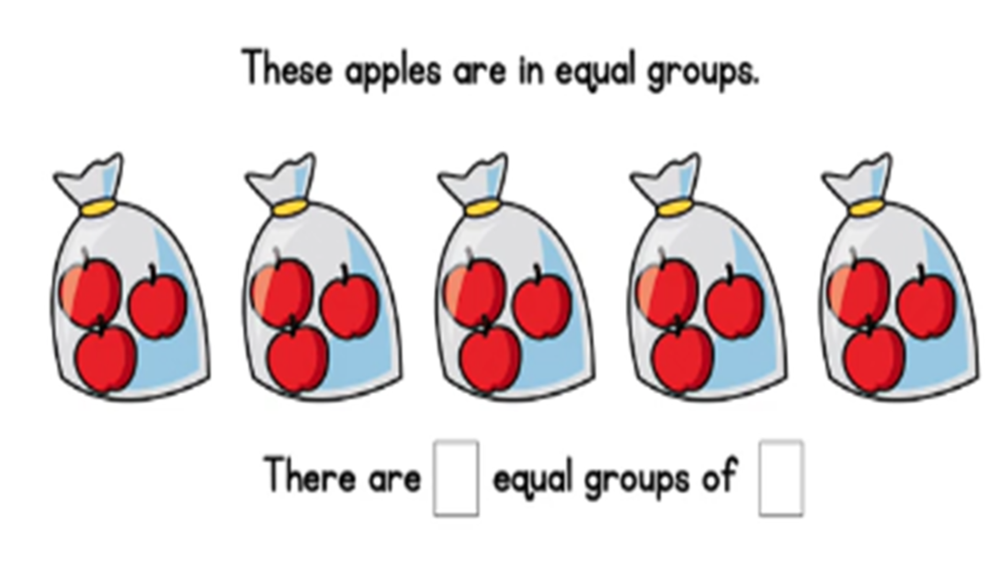
How many equal groups are there?
How many in each group?

Slide 29
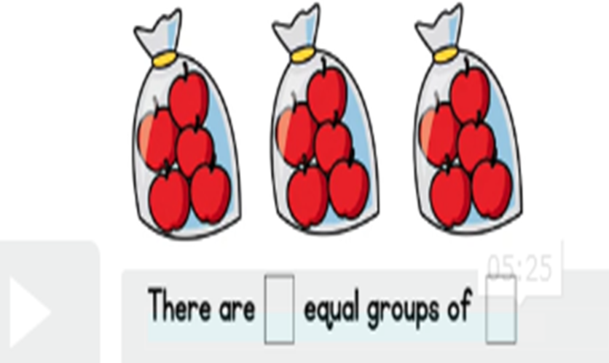
How many equal groups are there?
How many in each group?

Slide 30
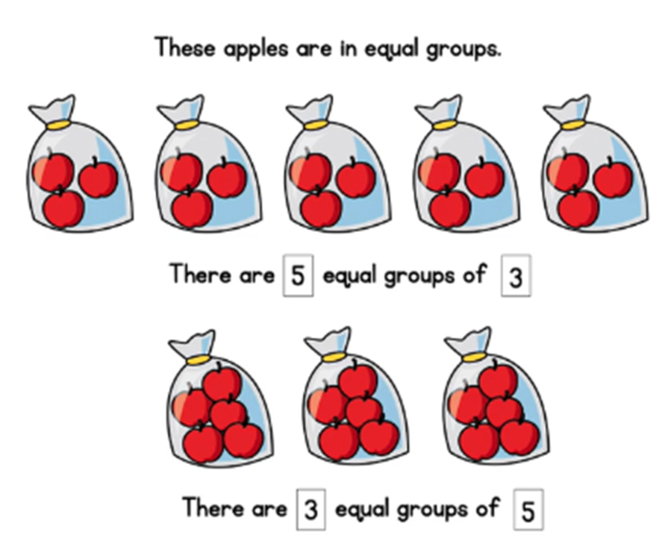
What is the same? What is different?
Did you notice that both have the total of 15 apples.

Slide 32
Worksheet for today’s lesson is available in links under ‘Wednesday’s Worksheet’.

Slide 33
Thursday 4th June 2020
L.O. To add equal groups.

Slide 42
Worksheet for today’s lesson is available in links under ‘Thursday’s Worksheet’.

Slide 43
Friday 5th June 2020
L.O. To add equal groups.

Slide 49
Worksheet for today’s lesson is available in links under ‘Friday’s Worksheet’.

