Slide 2
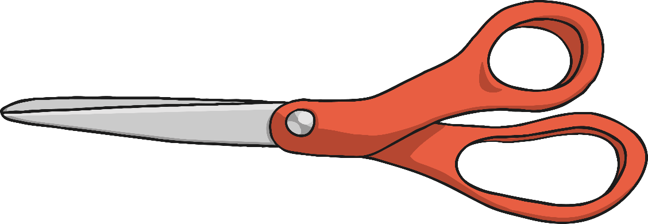
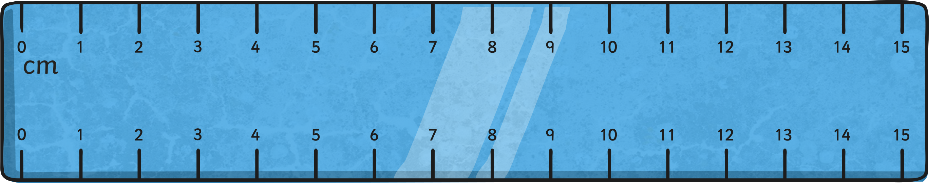
Step 1
Place the 0cm mark on the ruler at one end of the object you are measuring. Make sure you are using the centimetre scale. Do not measure from the end of the ruler.

Slide 3
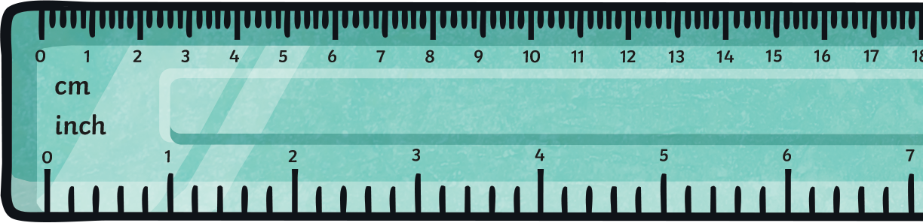
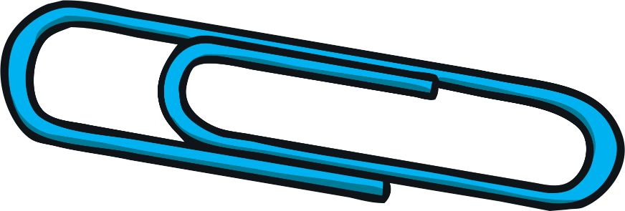
Step 2
To find the length of the object to the nearest centimetre, round the length up or down to the nearest number on the ruler.

Slide 4
Step 3
Count the number of intervals
after the whole centimetre to find the length of the object to the nearest millimetre.
Remember: 10mm = 1cm.

Slide 5
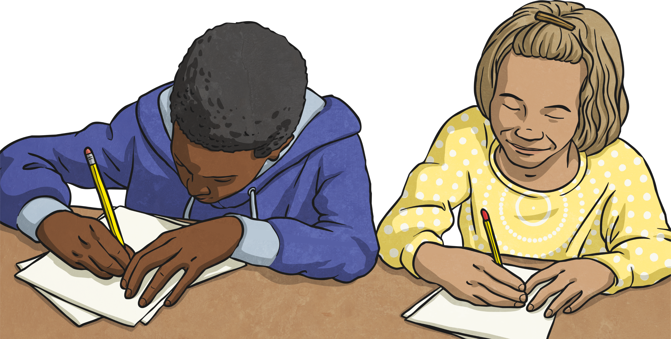
Step 4
Write down the length of the object in either centimetres
or millimetres.

