Slide 2
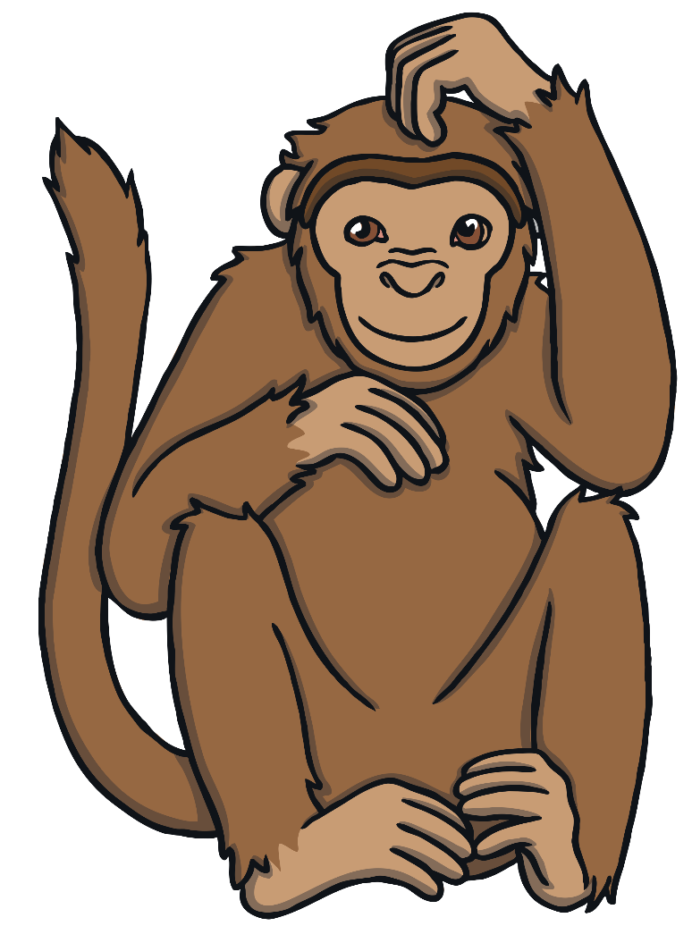
Introduction
My name is Max and I am a monkey. Mummy Monkey has helped me to collect some bananas to share with my friends.
Can you help me share the bananas fairly with my friends?
I need to share the bananas fairly so that each monkey has the same number.

Slide 3
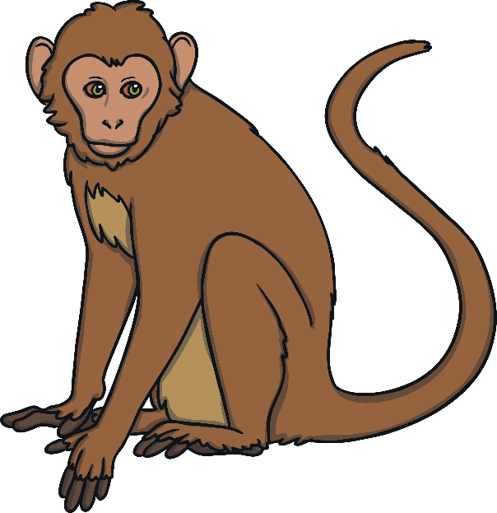
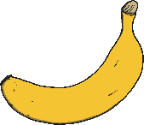
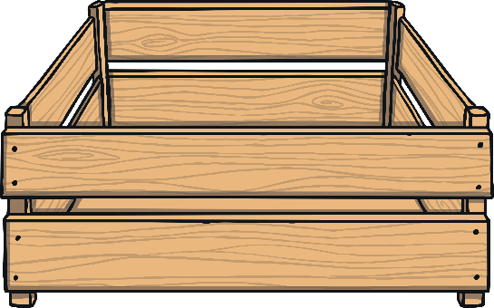
Here is Max.
Max has 12 bananas.
How many bananas have we collected?
Click on the bananas to share them.

Slide 4
Max’s friend, Marcia, would like some bananas too.
The bananas are not shared fairly.
The monkeys have different numbers of bananas.
What do you notice about the number of bananas each monkey has?
Click on the bananas to share them.

Slide 5
Can you help to share the bananas fairly between the 2 monkeys?
The bananas are shared fairly.
Each monkey has 6 bananas.
Are the bananas shared fairly? How do you know?
Click on the bananas to share them.

Slide 6
Now, Max’s friend Marcel would also like to share the bananas.
Does each monkey have the same number of bananas? How can you tell?
Click on the bananas to share them.
The bananas are not shared fairly.
Each monkey has a different number of bananas.

Slide 7
Can you share the bananas fairly between the 3 monkeys?
What is 12 shared between 3? Count how many bananas each monkey has to work out the answer.
Click on the bananas to share them.
The bananas are shared fairly.
Each monkey has 4 bananas.

Slide 8
Mummy Monkey would like some bananas too! How many bananas does each monkey get?
The bananas are shared fairly.
Each monkey has 3 bananas.
Click on the bananas to share them.

Slide 9
Thank you for helping us to share the bananas fairly.

