Slide 1
INTENTIONS FOR WORKSHOP
GET TO KNOW ASSEMBLIES
‘WHATS IN MY BAG’
SIDE BY SIDE PROJECT
EXTENSION PROJECT
PROGRESSION AND ACHIEVEMENT
WHERE IS THOU STEM?
AOB

Slide 2
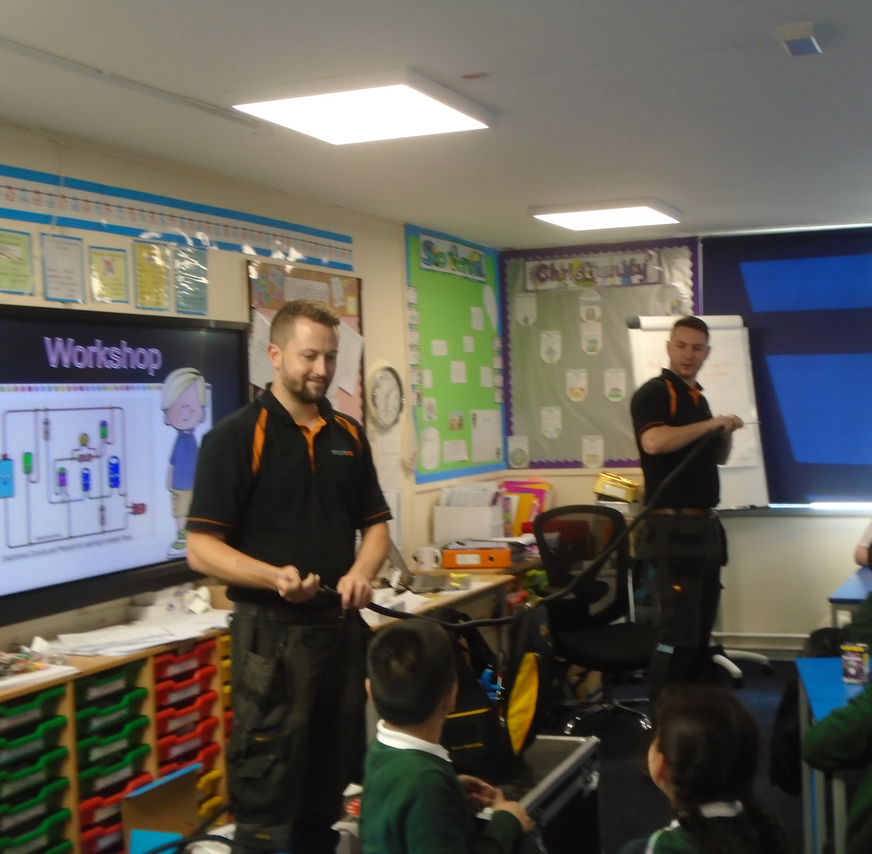
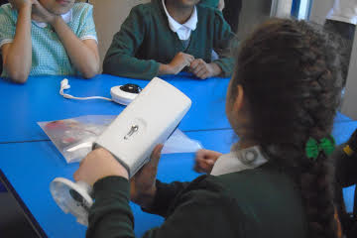
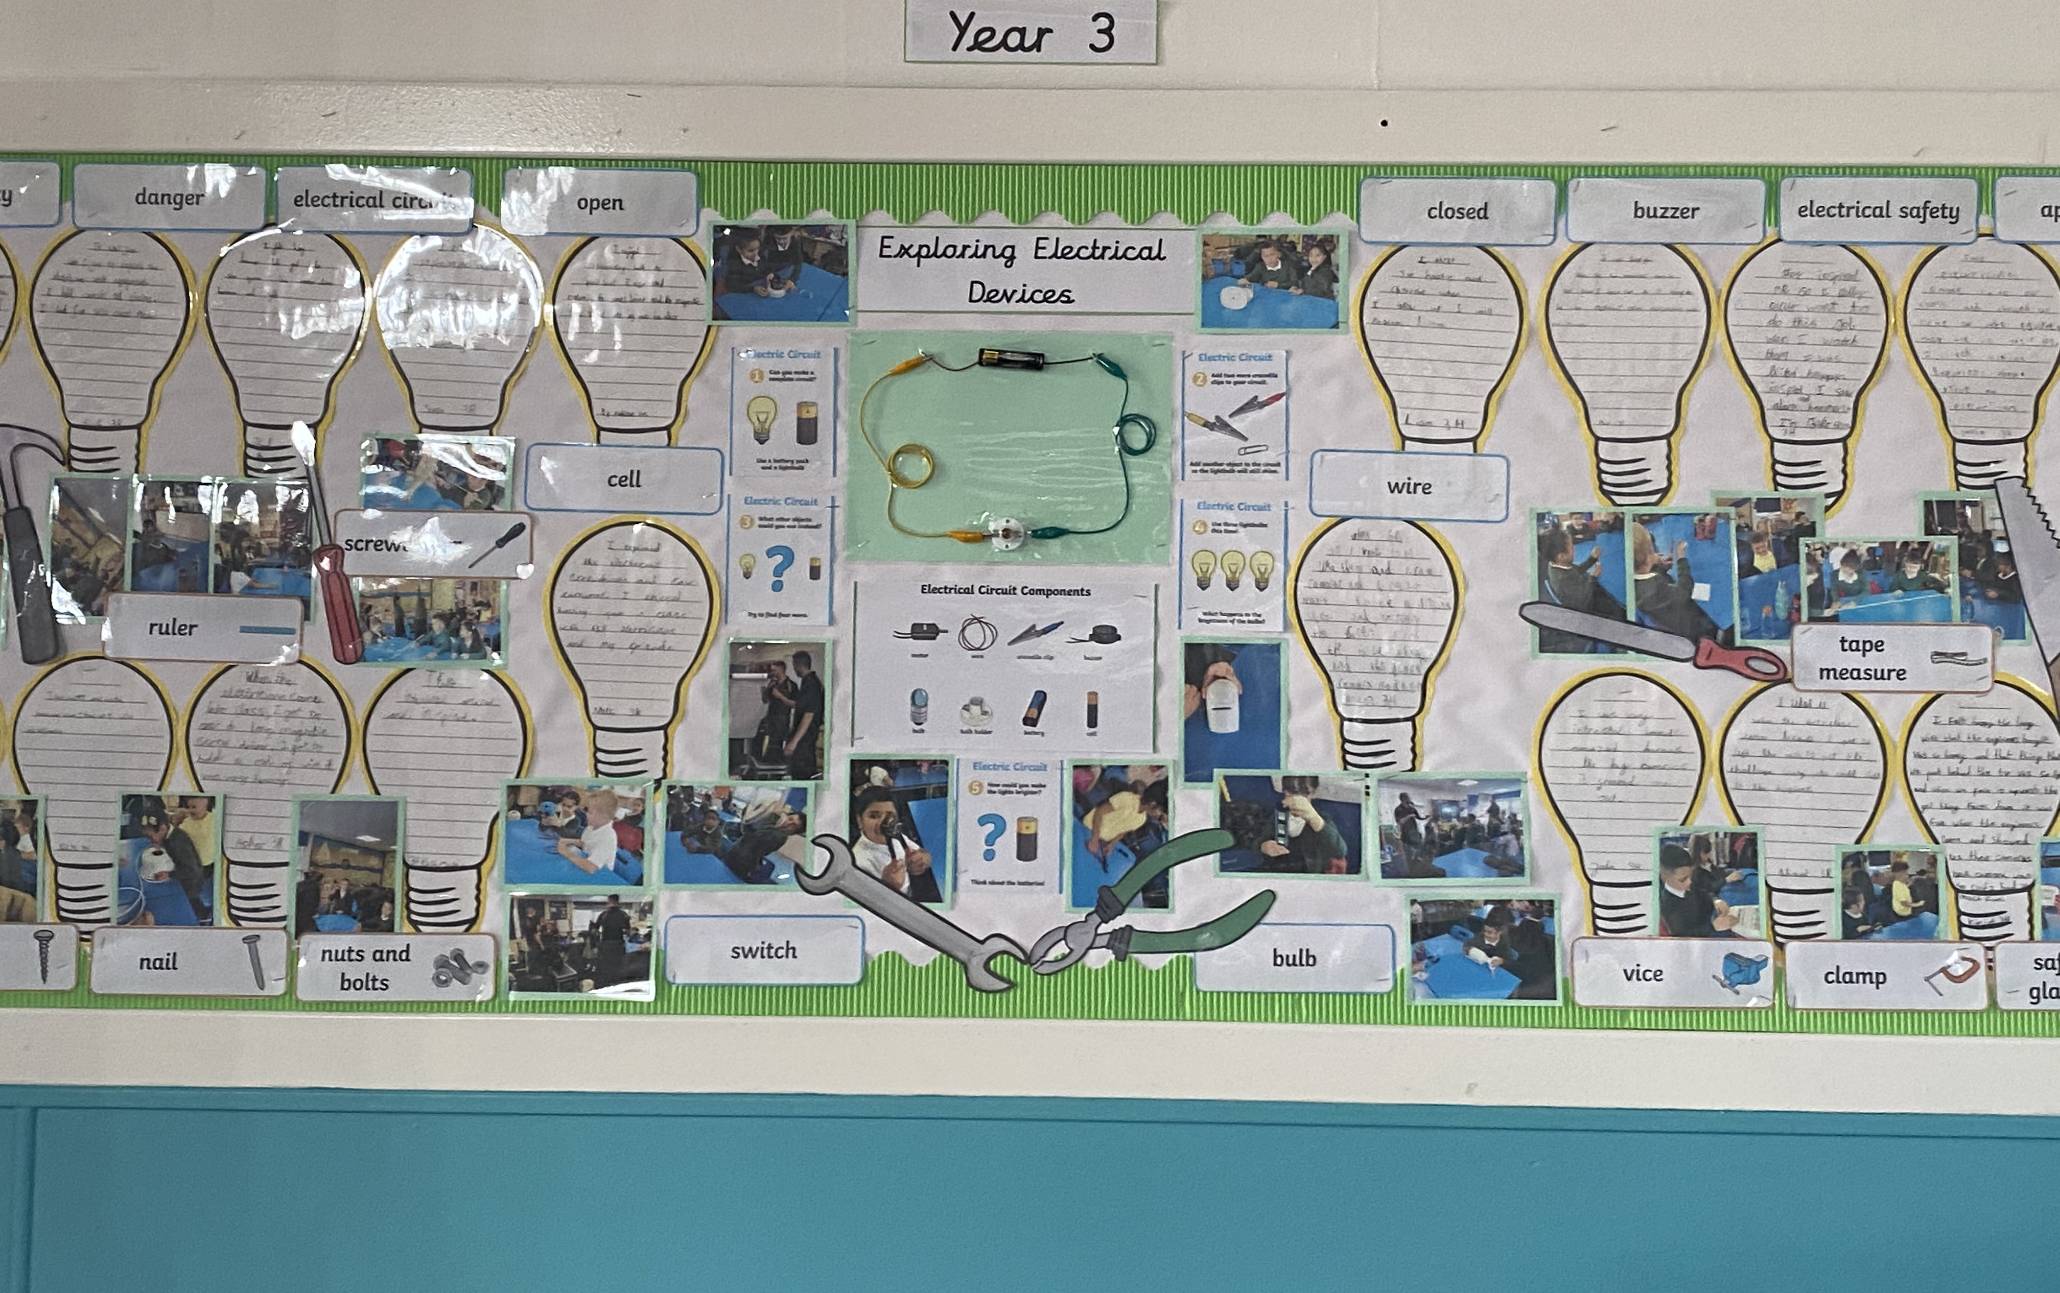
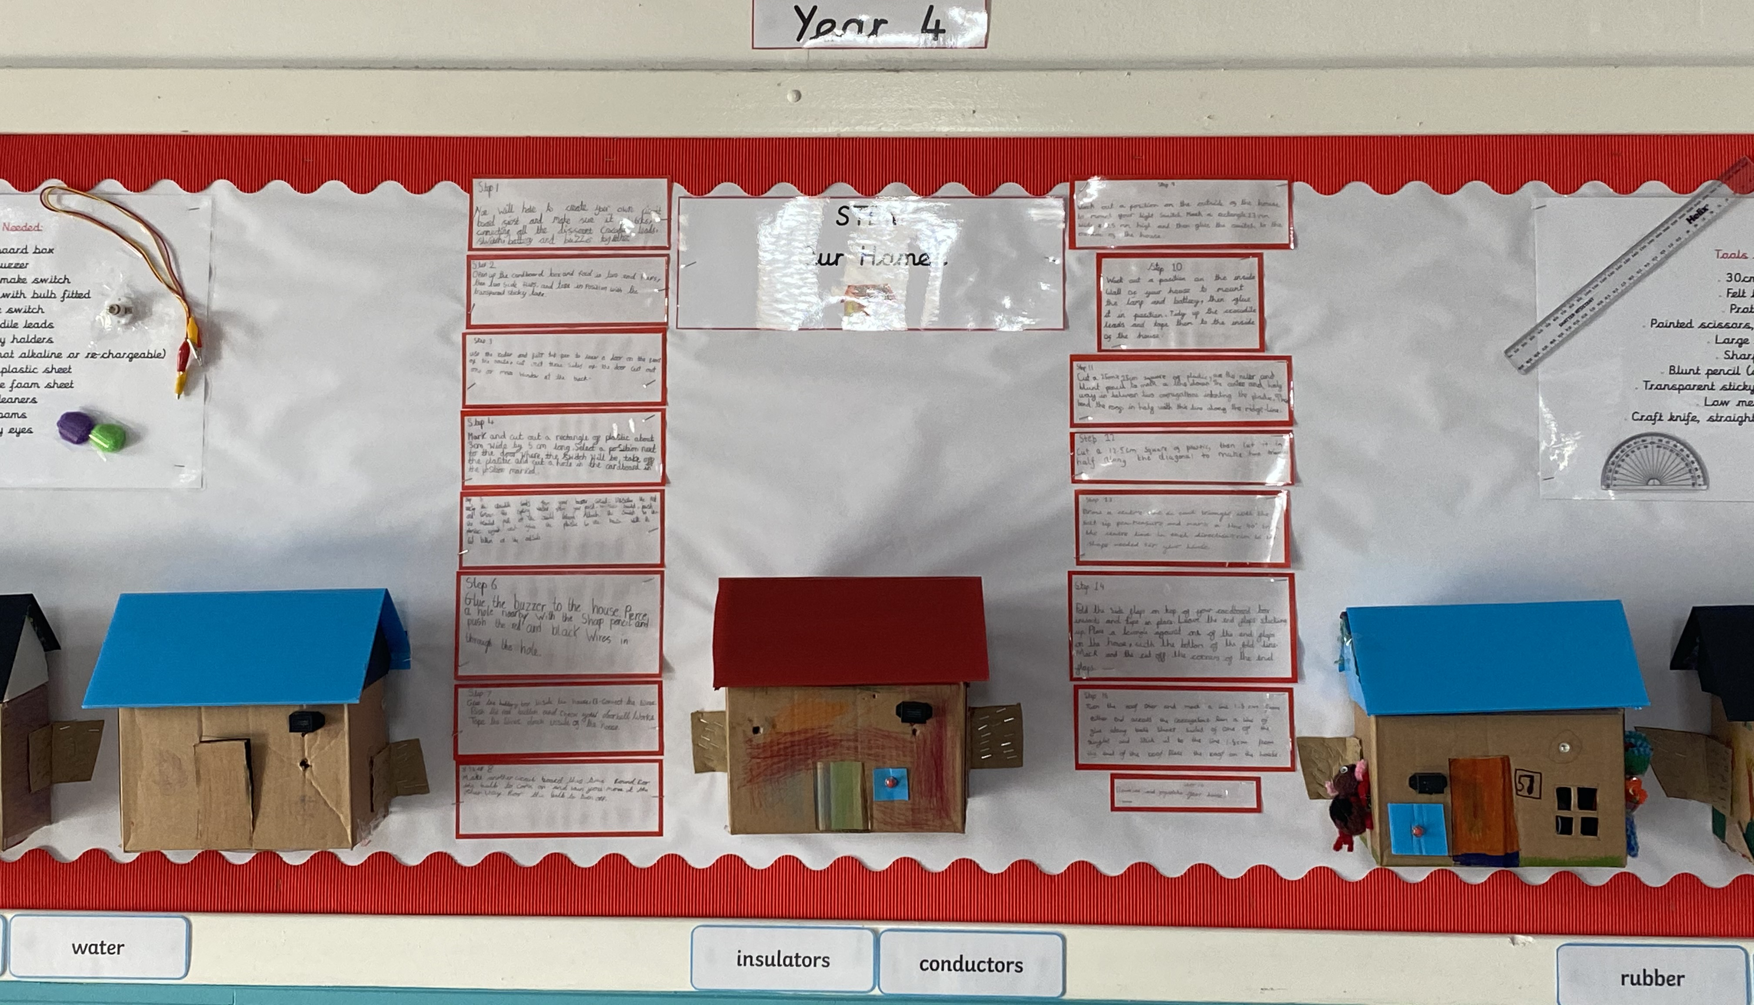
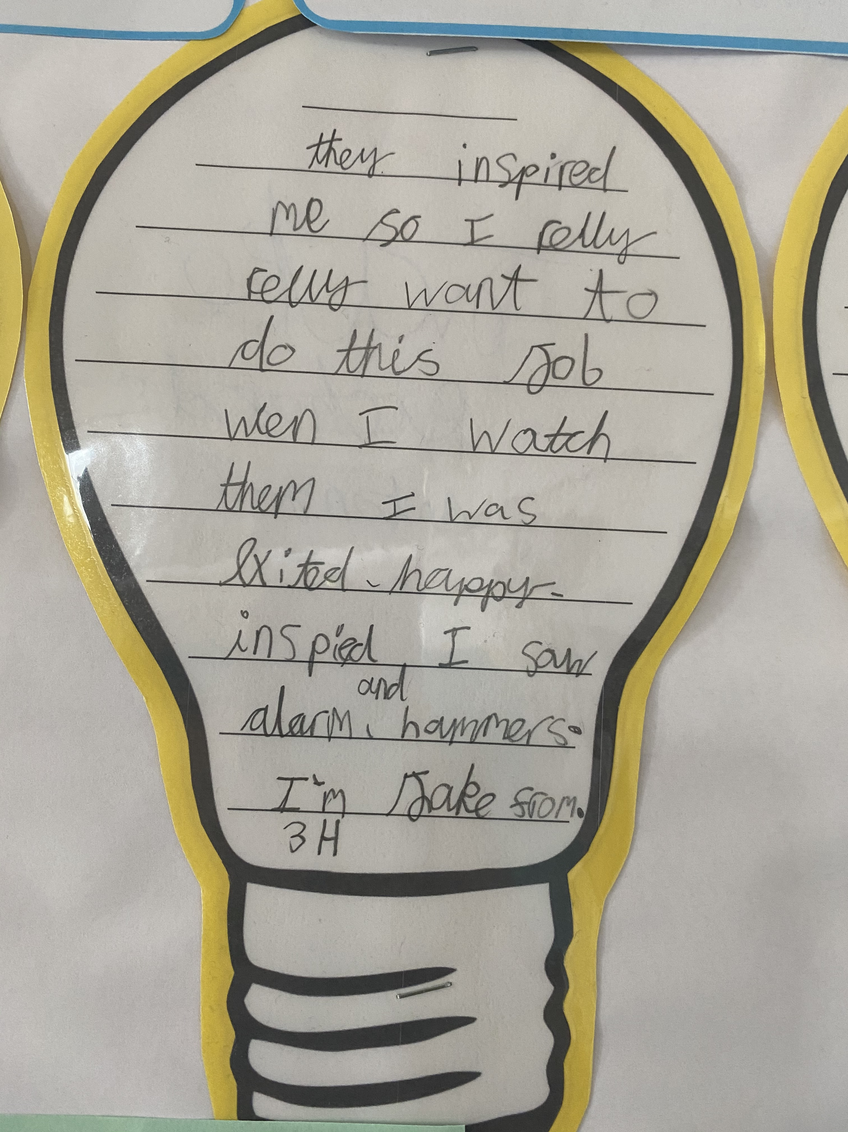
What we found out
Pupil feedback
'It was amazing'
Wow'
'It was so cool'
'I liked that the engineers talked about a lot of facts in the videoconference which could help me when I get older'.
'I learnt how to be an engineer'
Staff feedback
The children in my class really enjoyed the workshop. They were very excited to find out we would be learning more about the topic in year 4 and some were asking if we would be doing it again.
They loved getting to explore the equipment and find their own ways to make it
work.
'Loved it, this is what our children need. They need to know what an engineer is and that they can be one too'.
The children were engaged because of meeting the engineers.

Slide 3
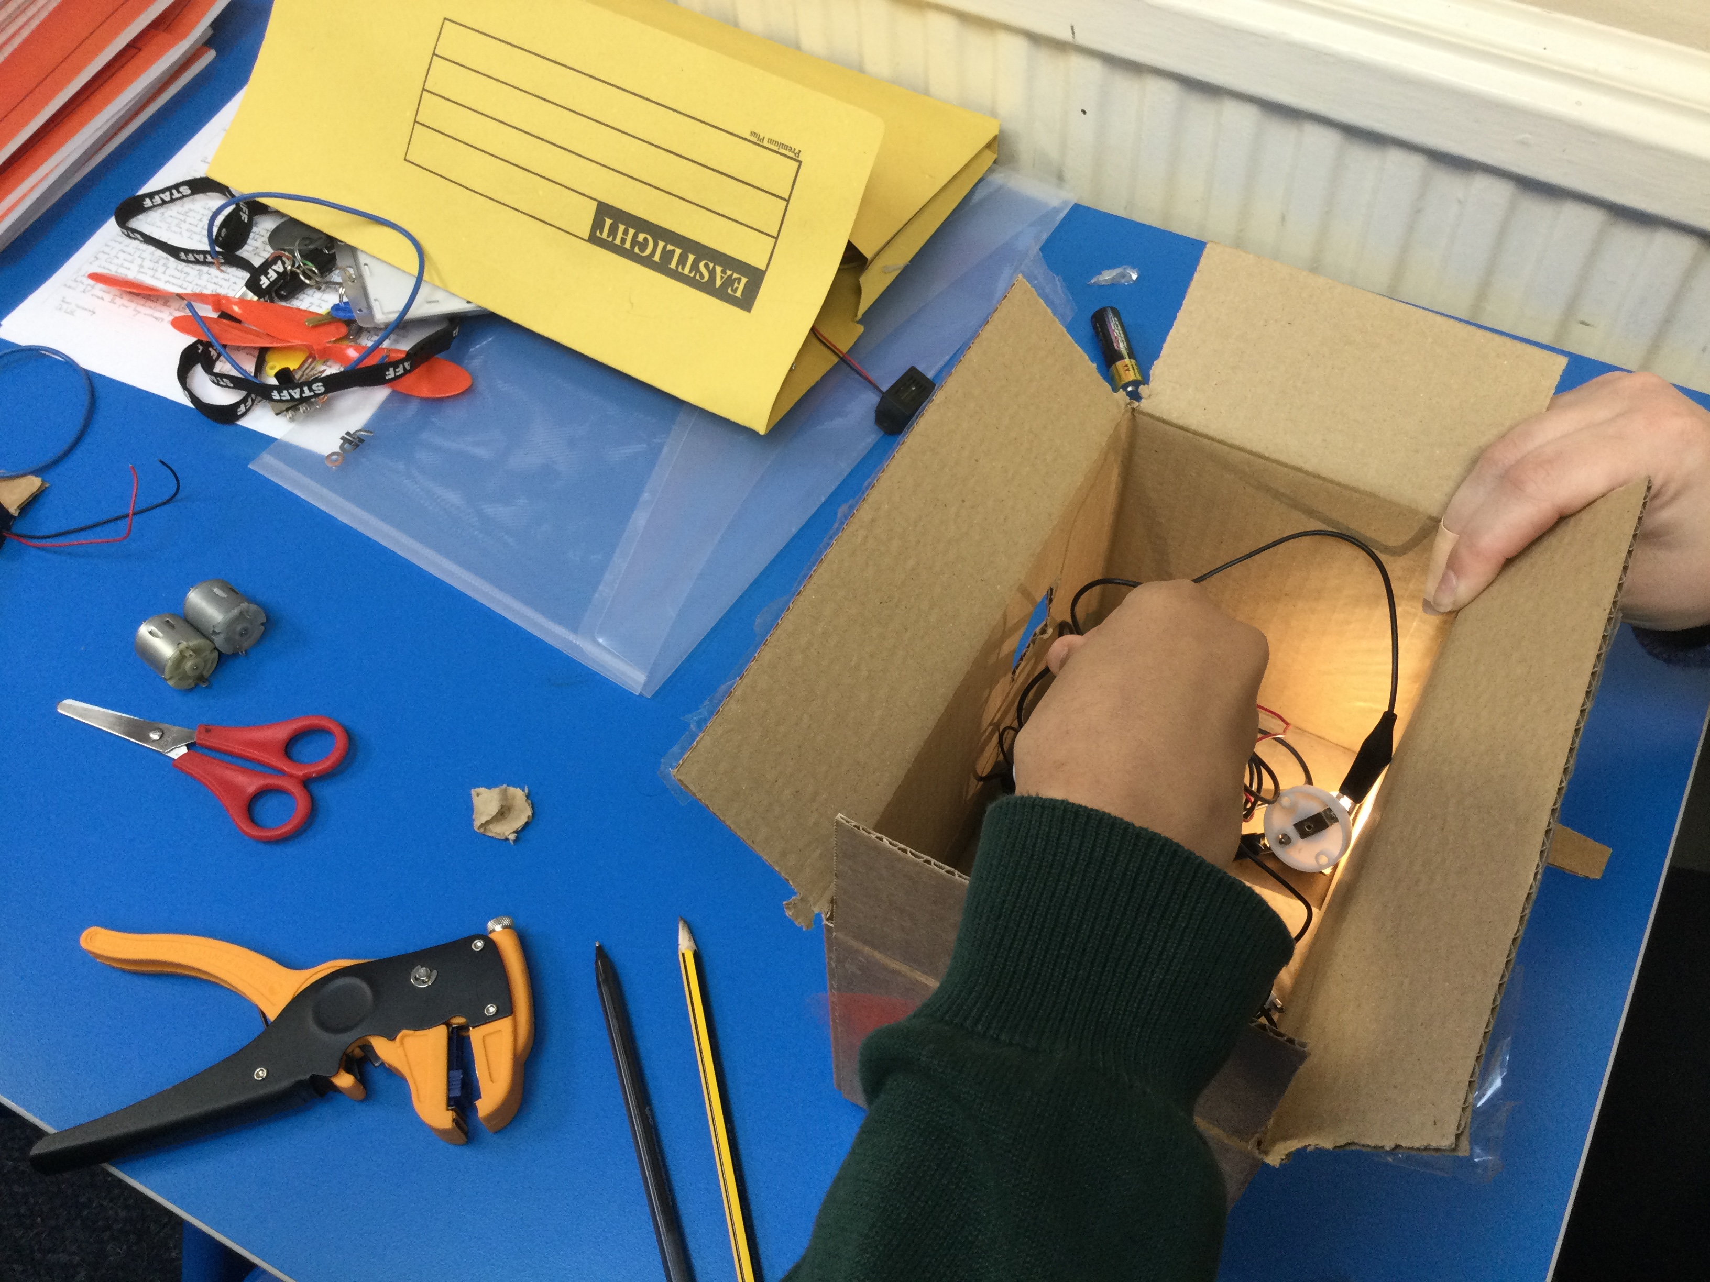
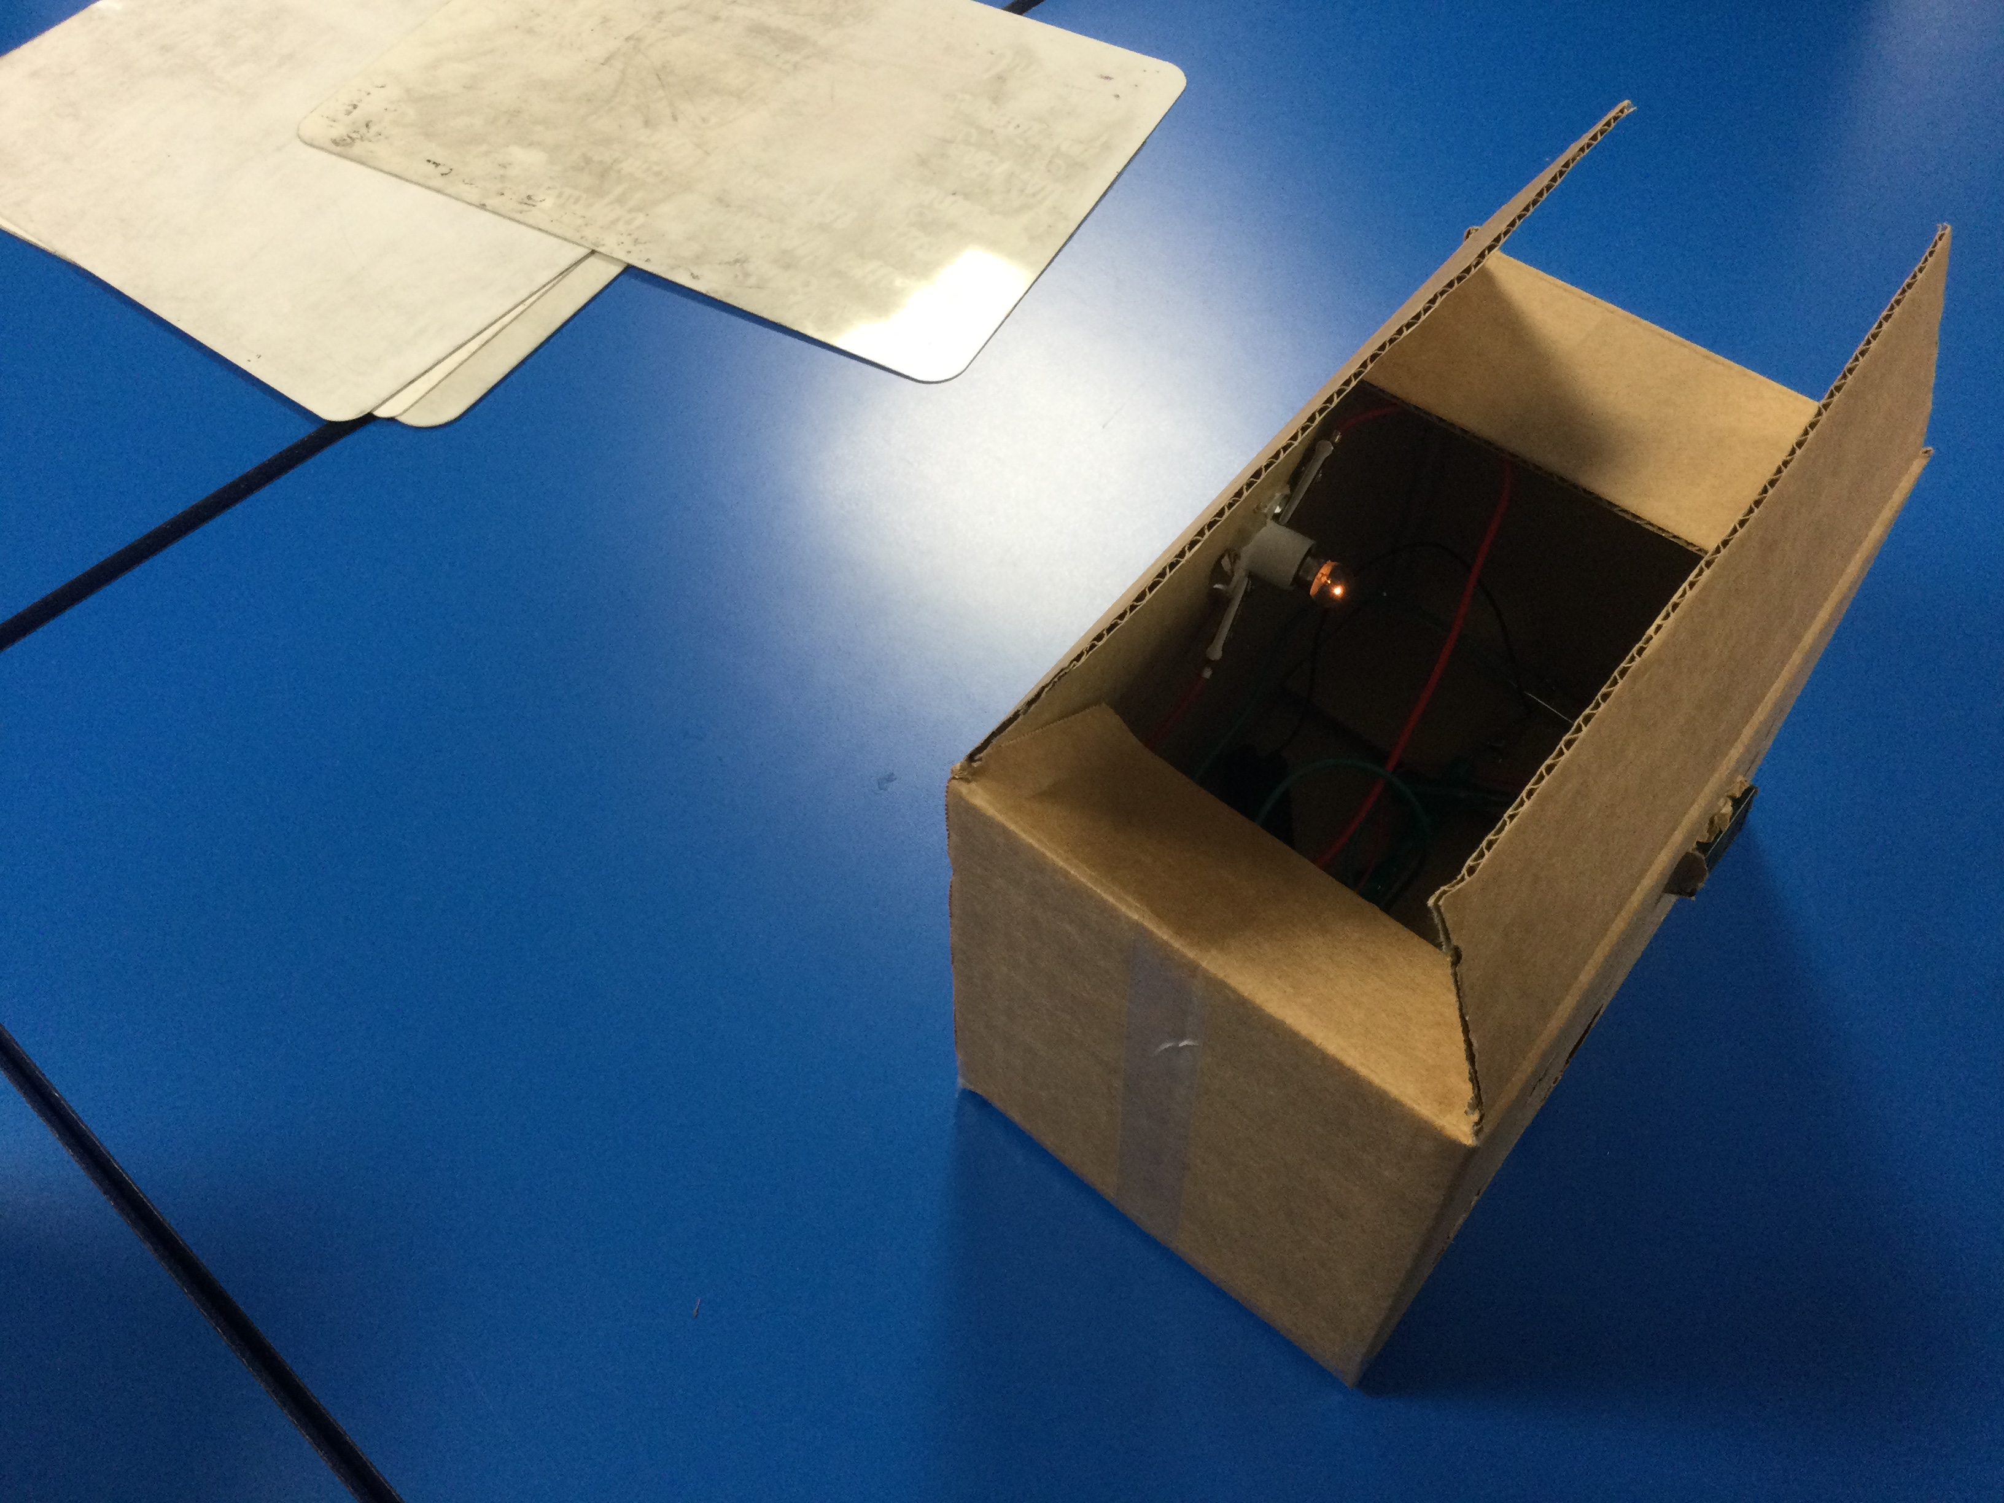
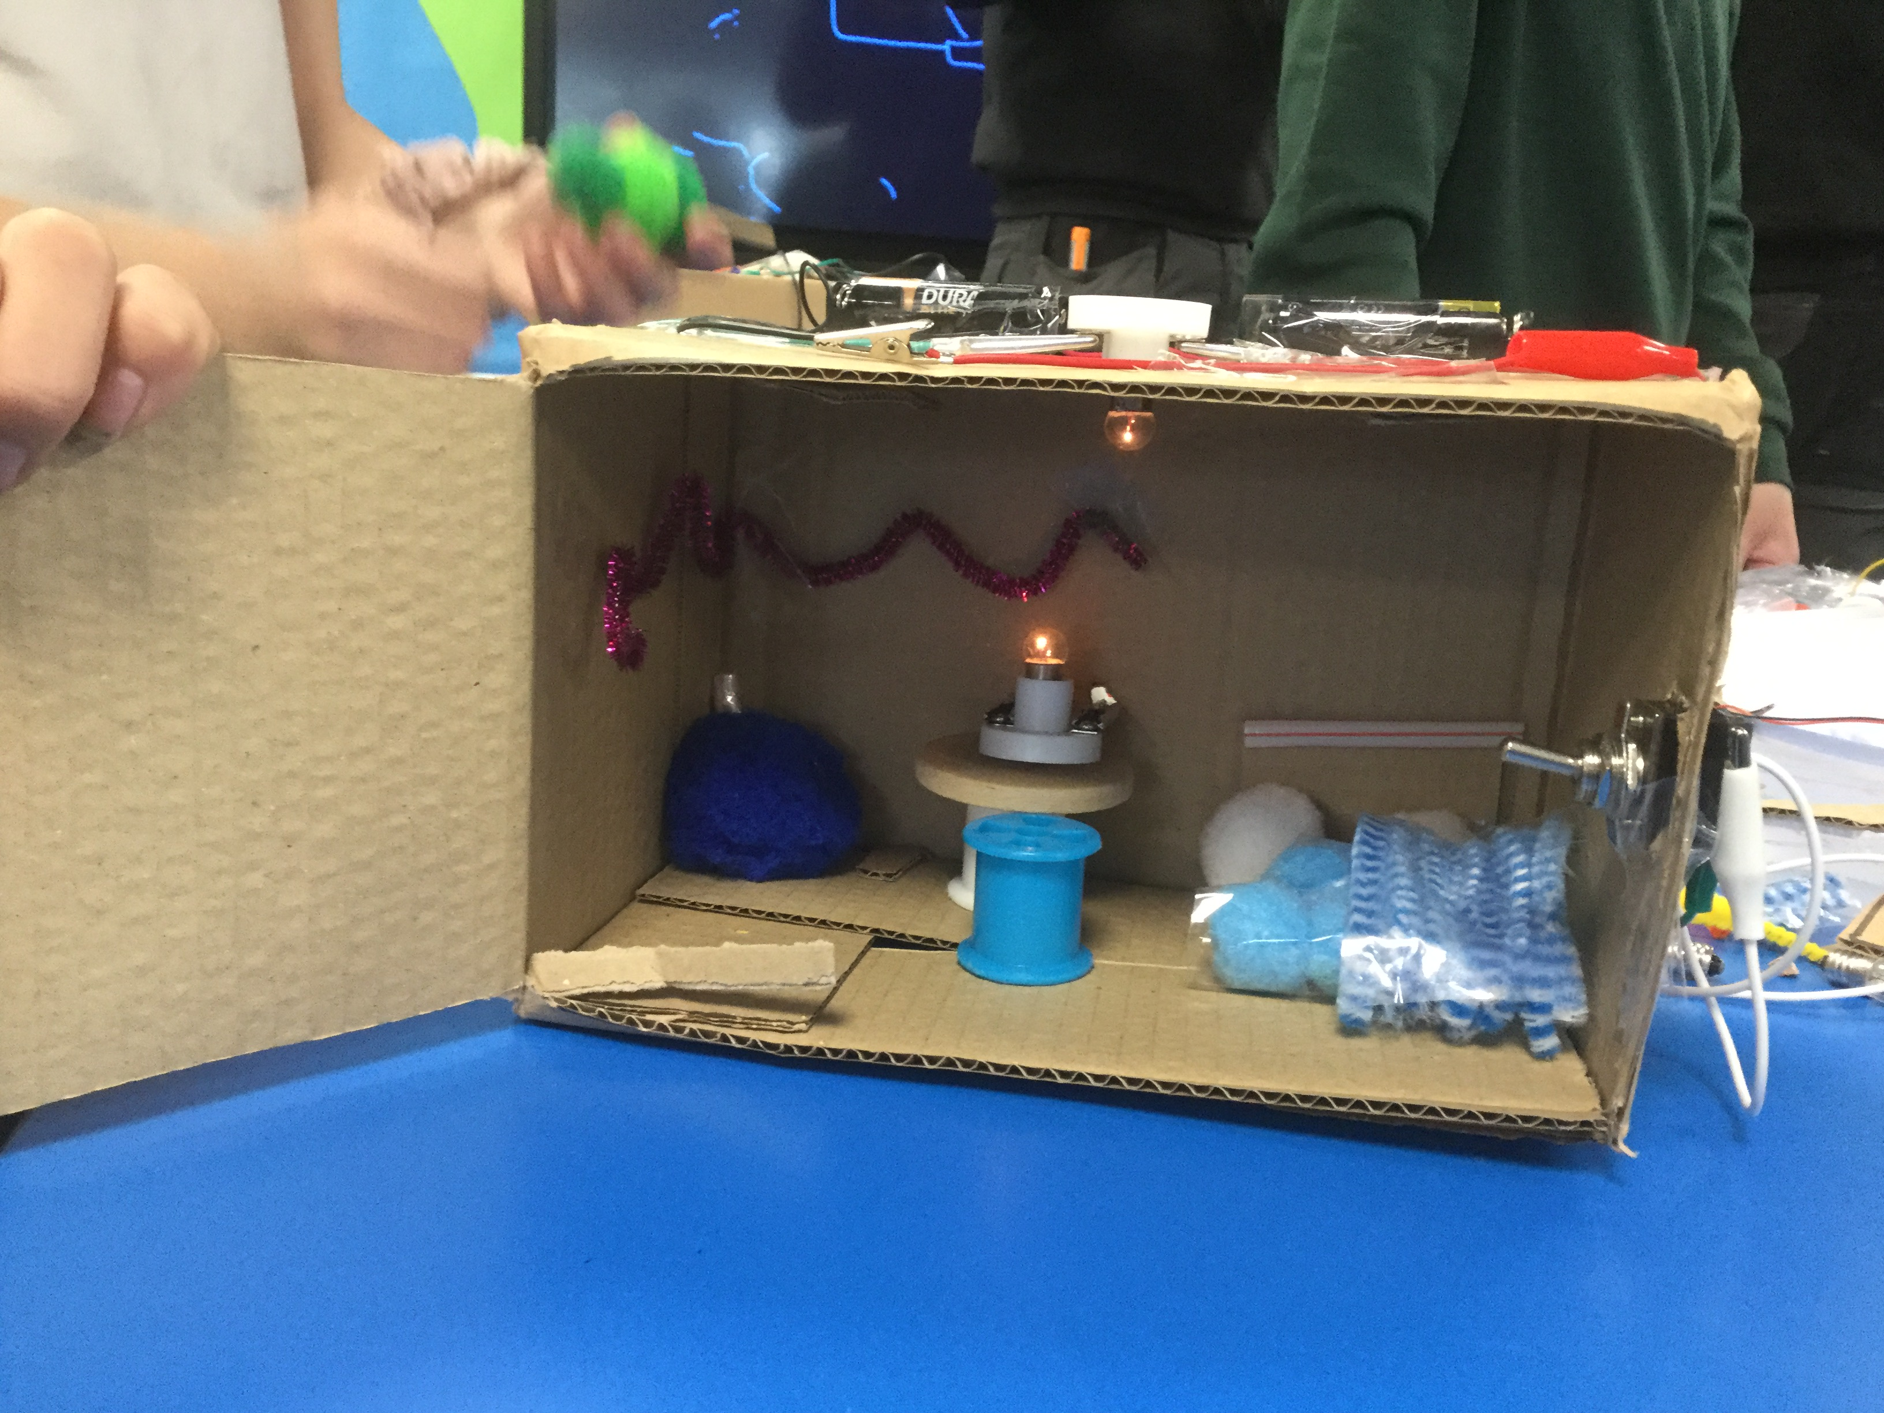
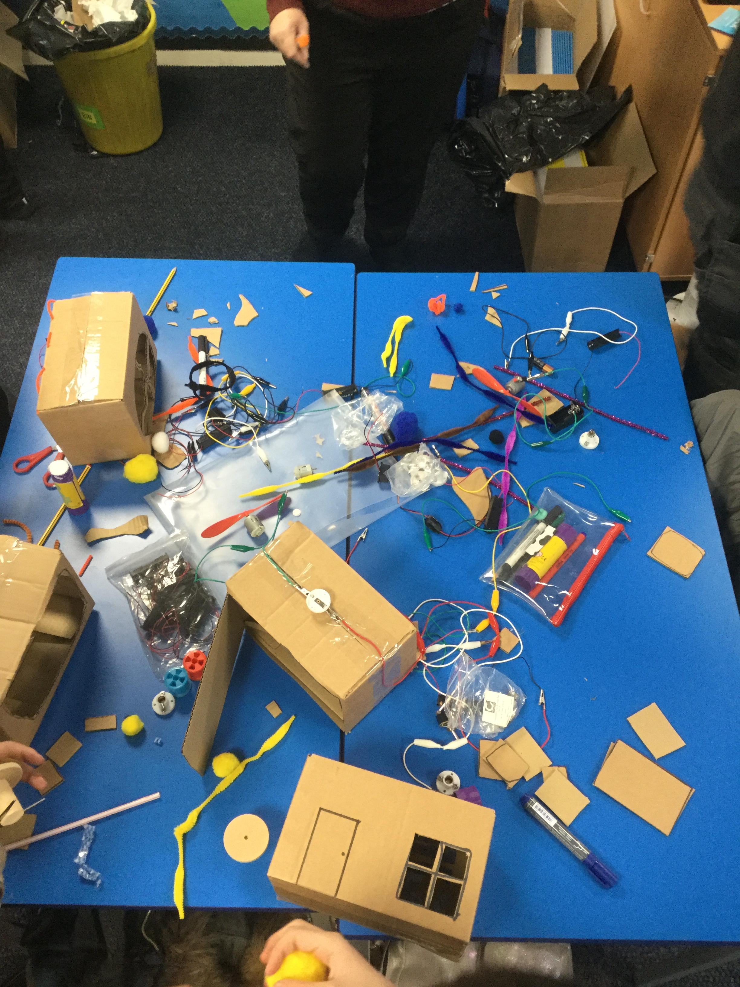
What we found out in Year 6

Slide 4
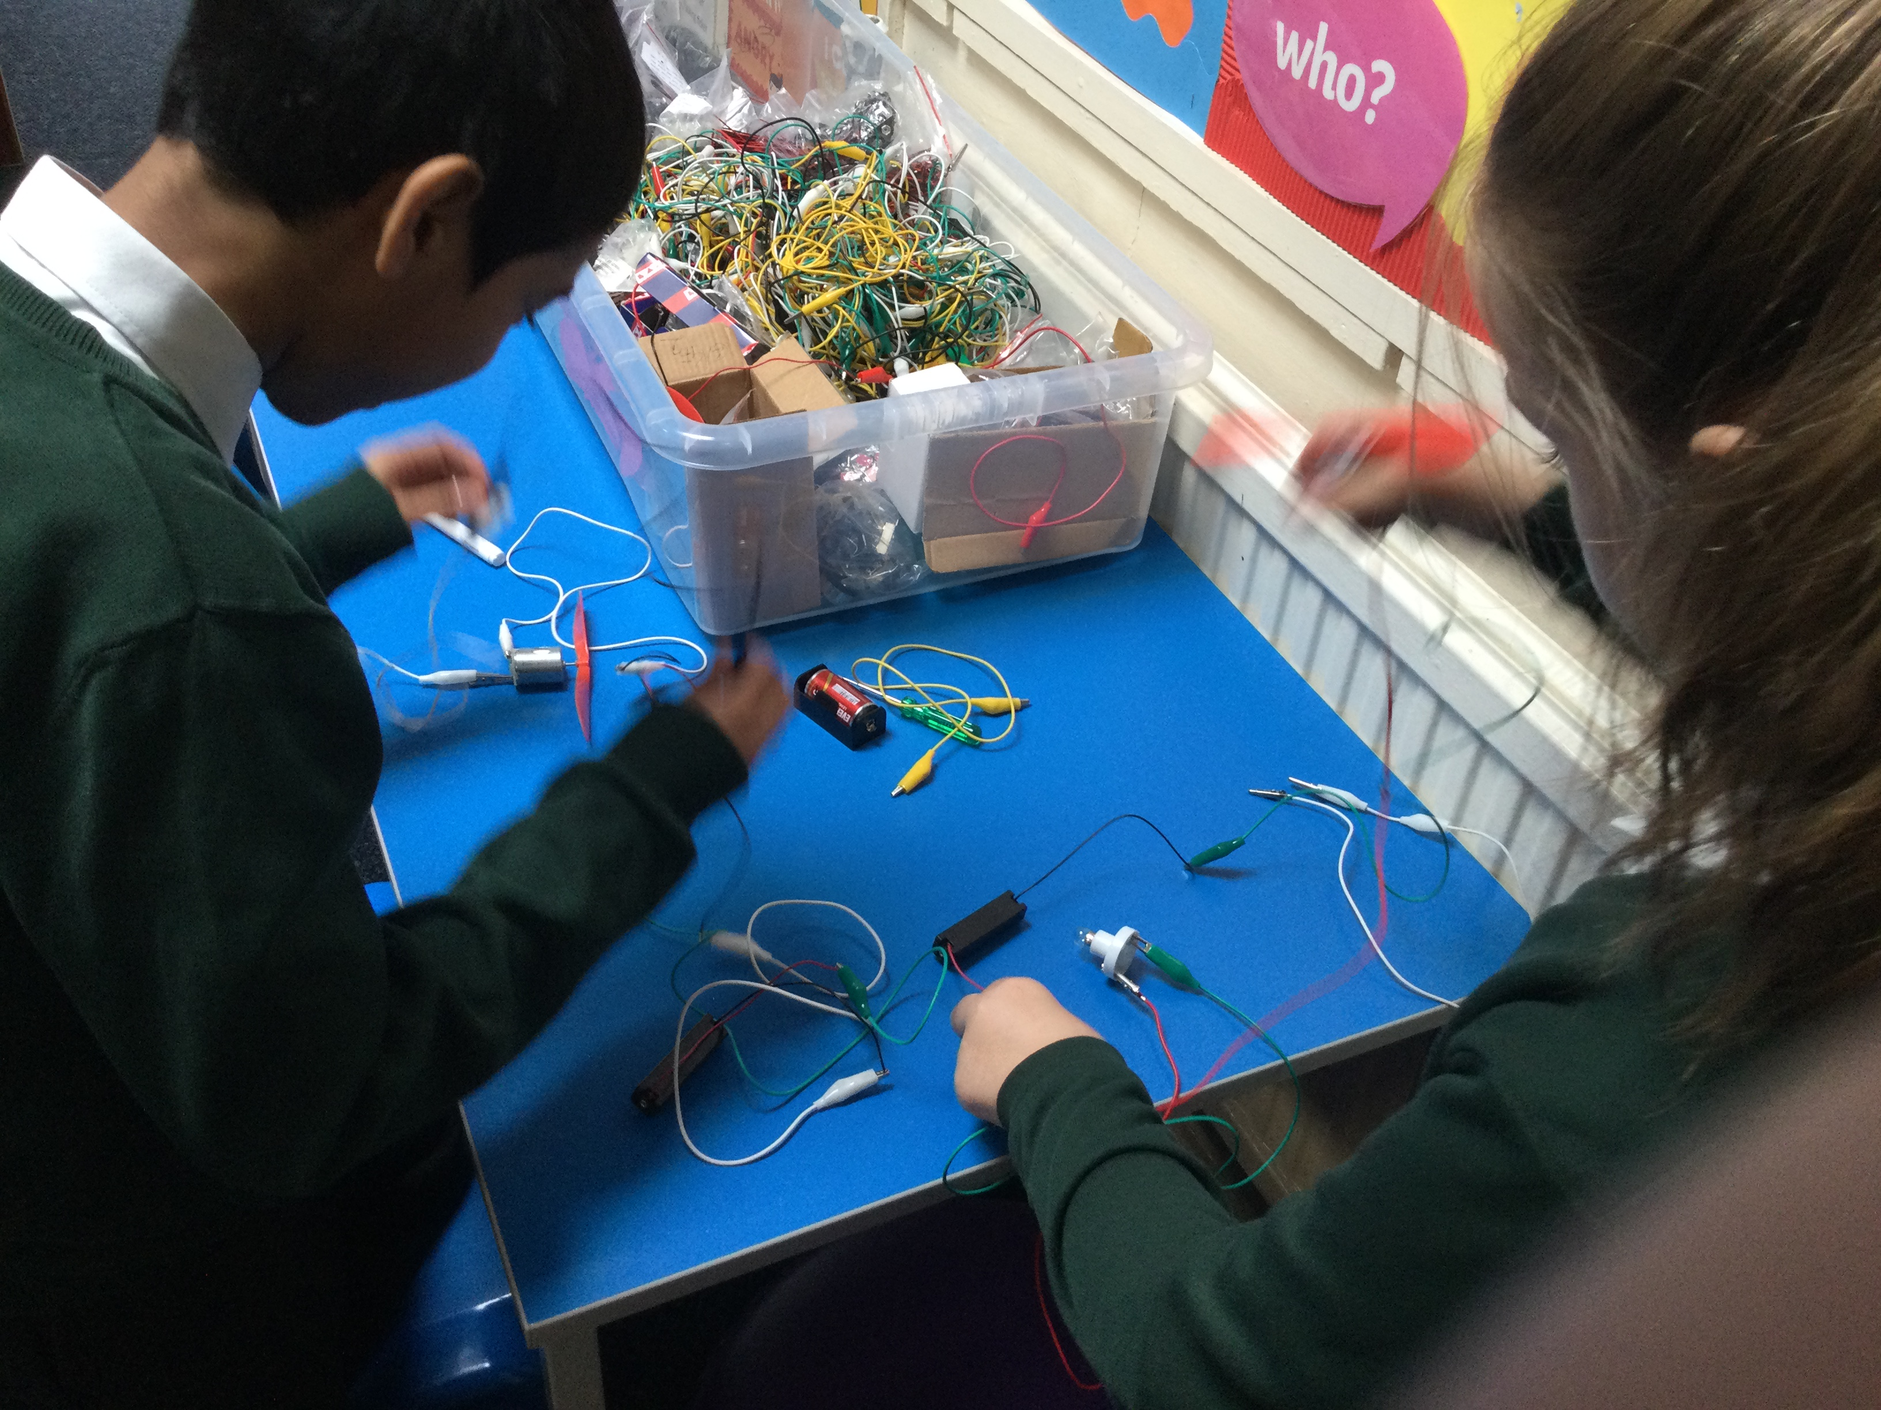
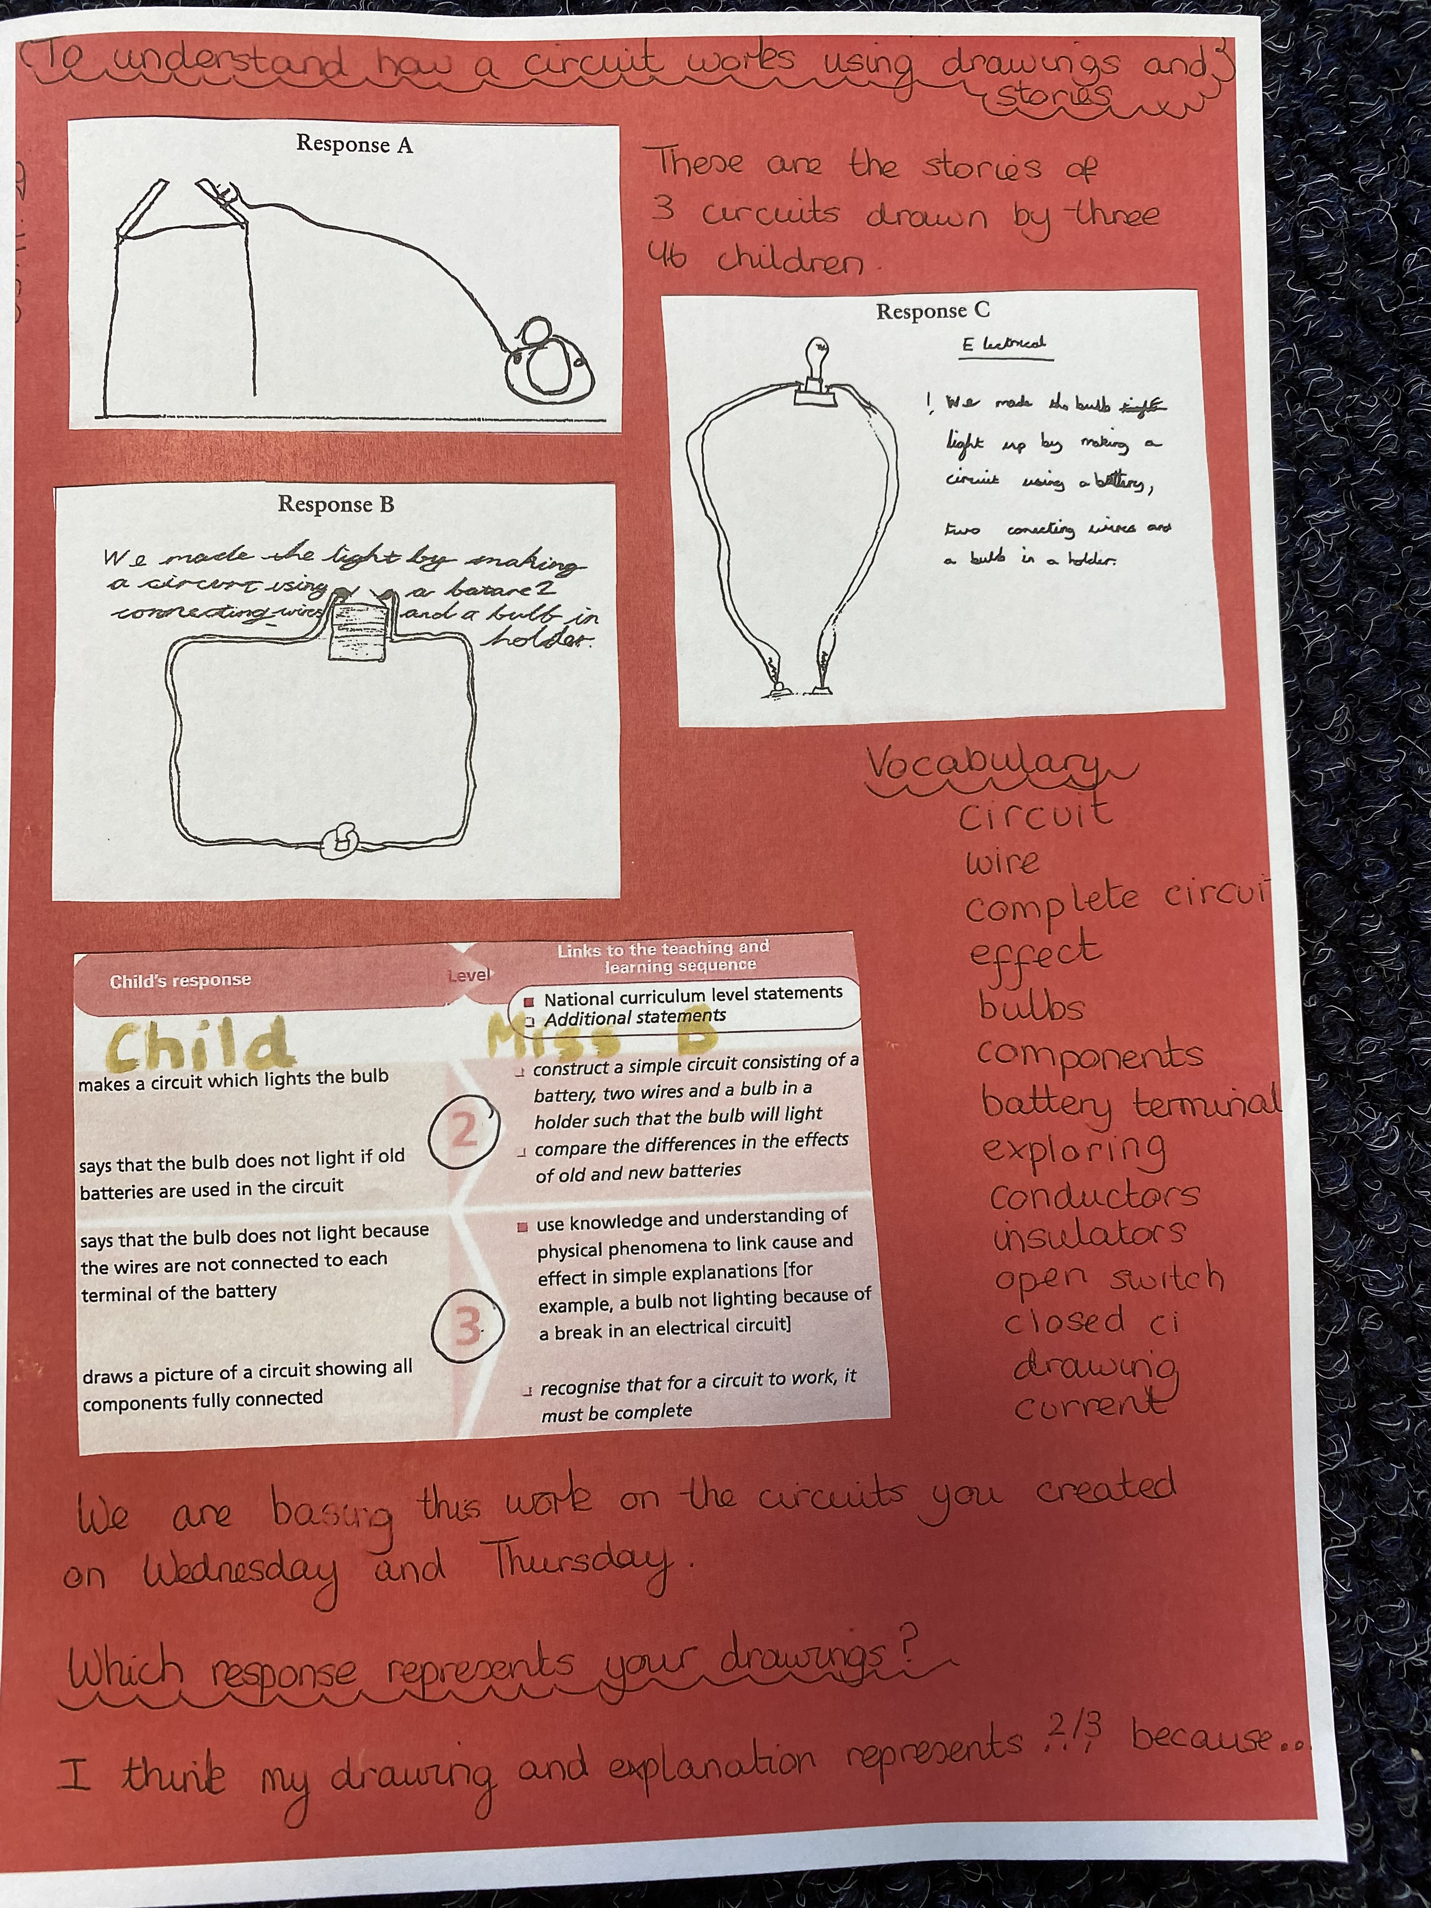
5) Progression and achievement
Dominoes
Resistance

